Slide 1

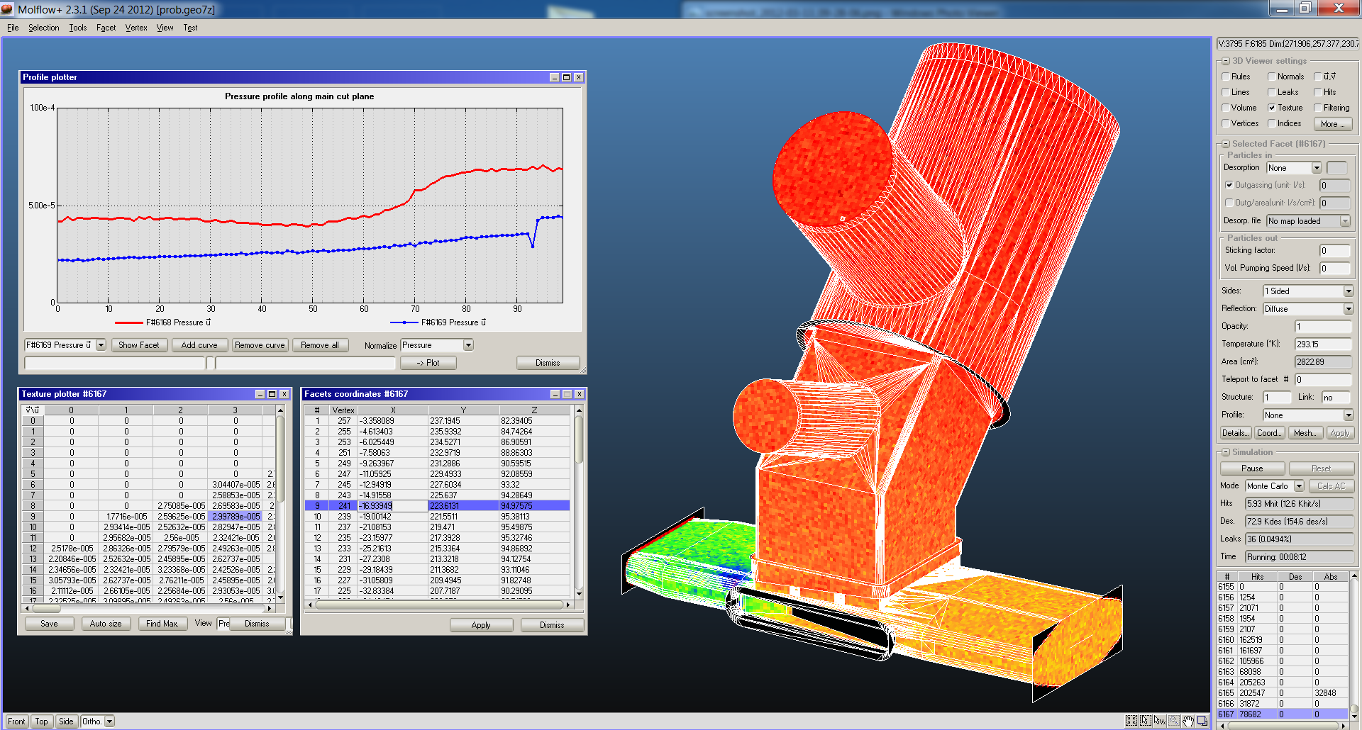
Gas simulations with
Monte Carlo methods
TMP study meeting, KEK
31st May 2024 - Marton Ady

Slide 2
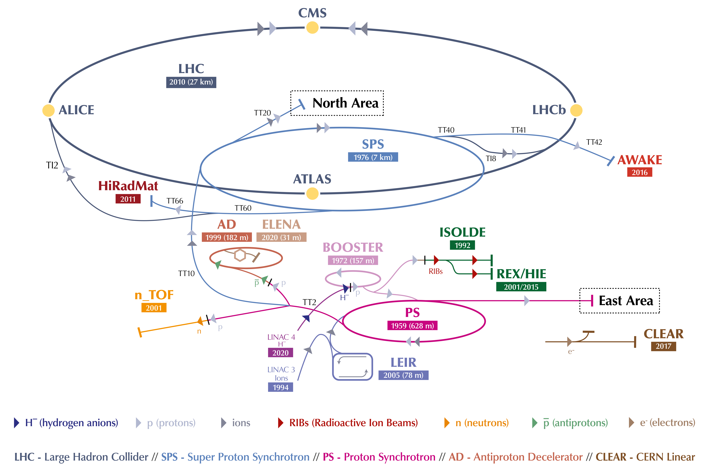
slide and animation: J. De la Gama / Iker Lobato Sola – VSC Seminar – 2024

Slide 4
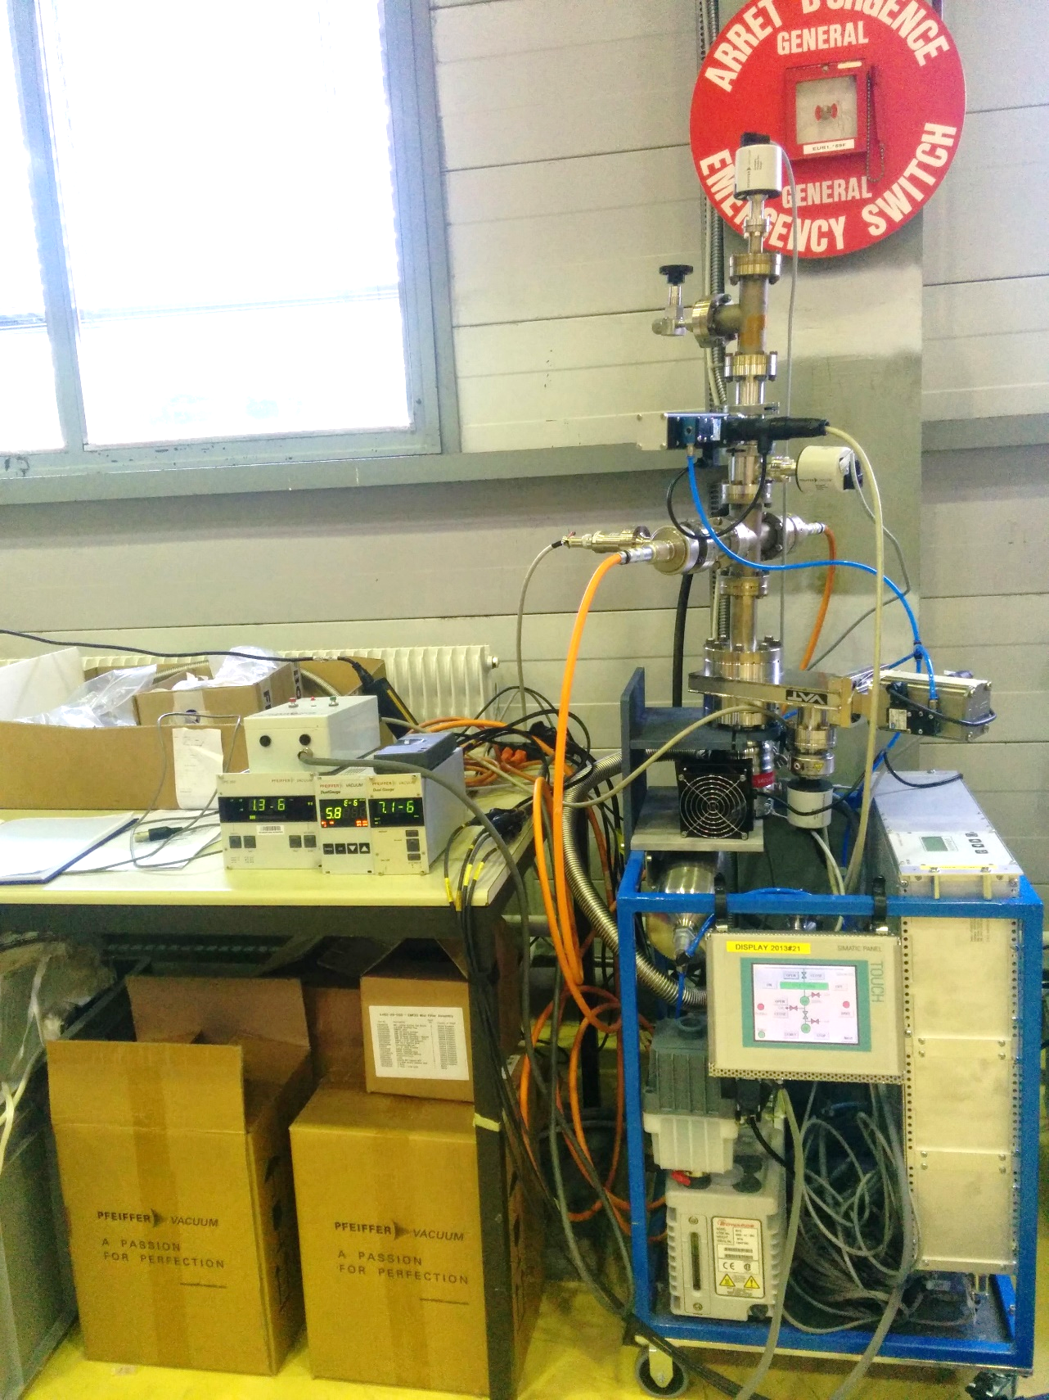
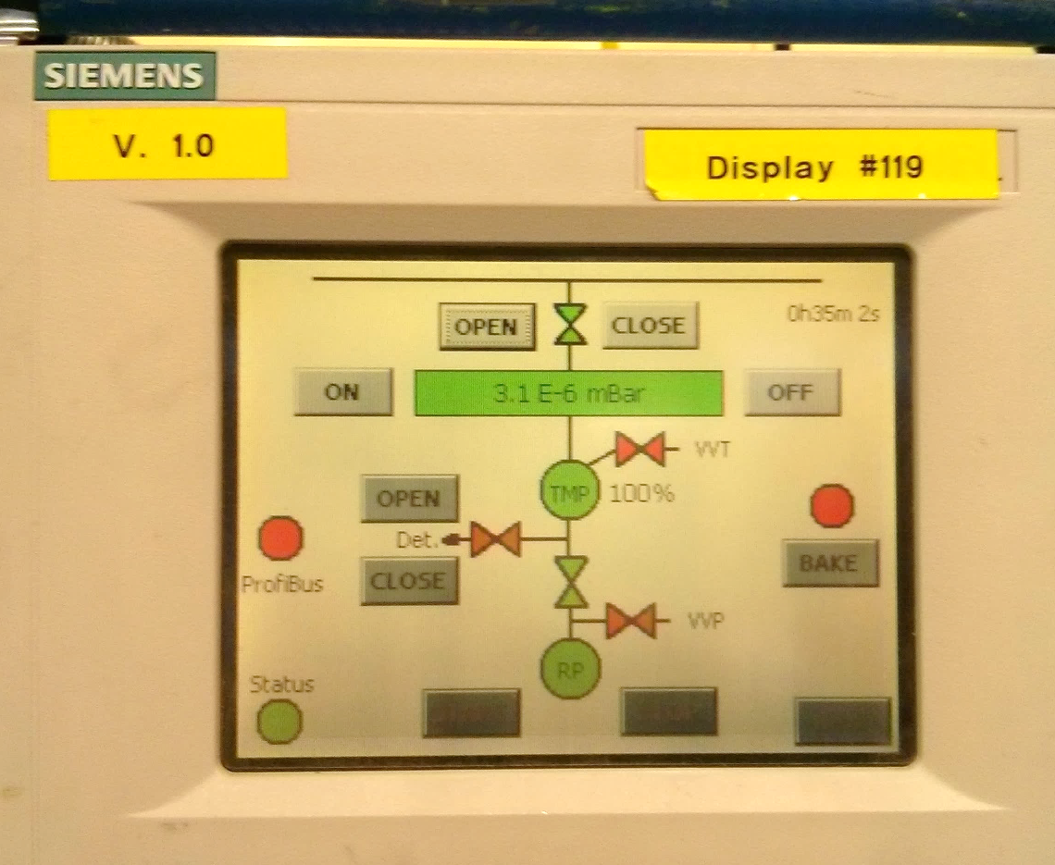
LHC Pressure: below 0.0000000000001 * atmosphere (10⁻¹⁰ mbar)
Gauges
LHC dipole
LHC dipole
Valves
Pump
Pump
Pump
Venting
Leak detection
Bakeout
Pumps

Slide 5
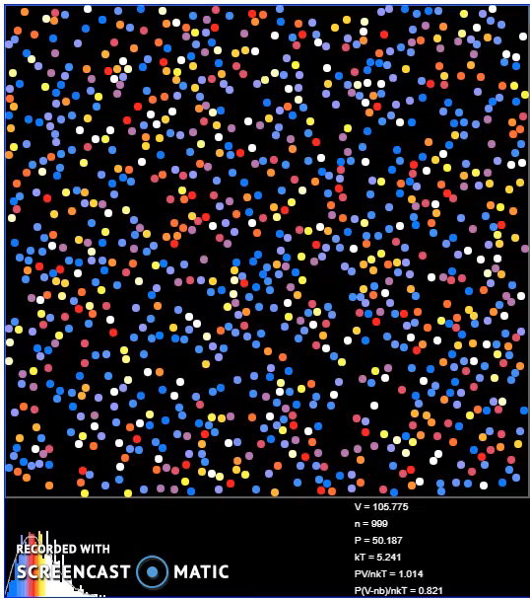
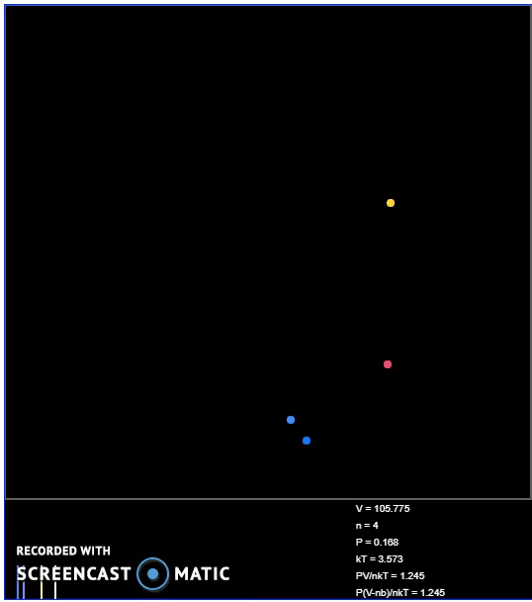
High pressure: fluid dynamics
High vacuum: random walk
Pumping by suction
Pumping by capture

Slide 6
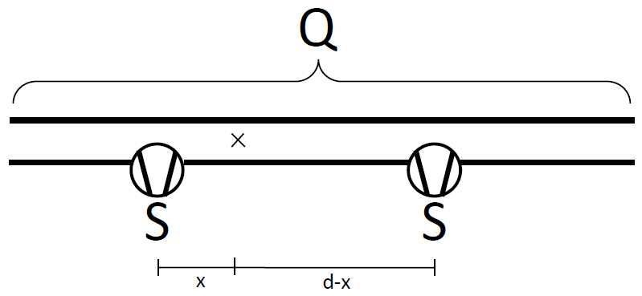
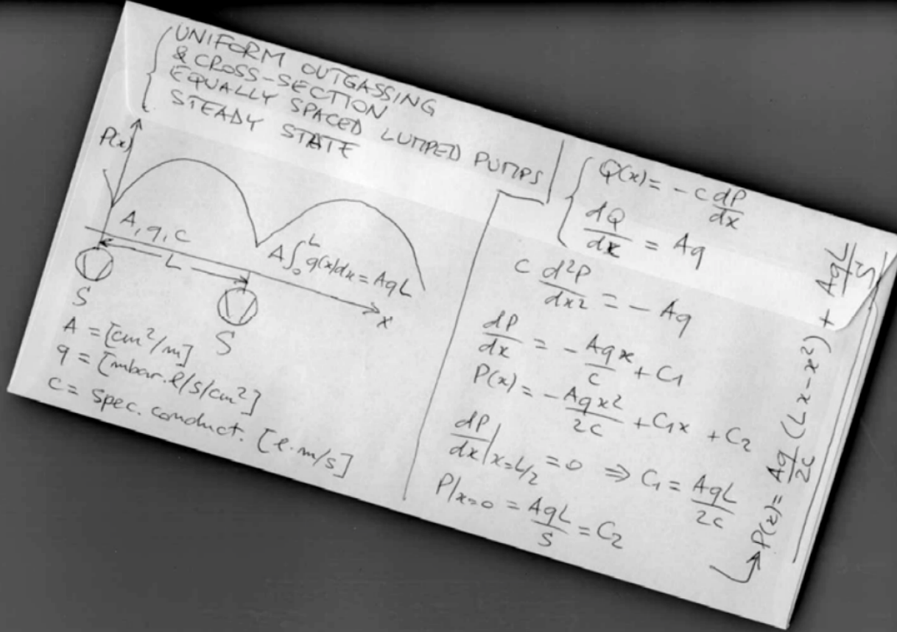
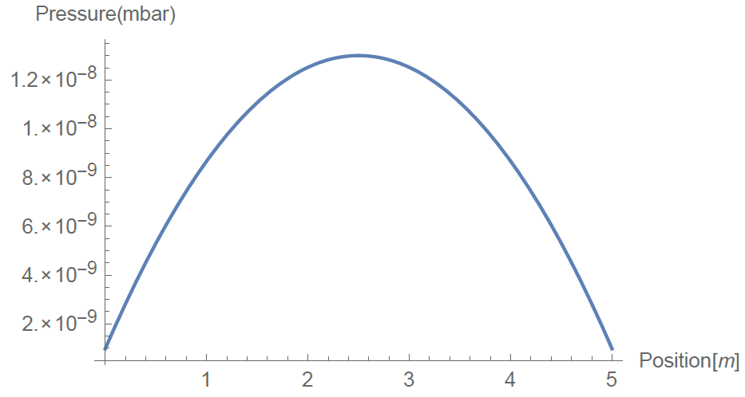
Analytic methods
Gas input
Pumping speed
p=Q/S
Q=C*dp
Pressure
Gas throughput
Conductance
Pressure difference

Slide 7
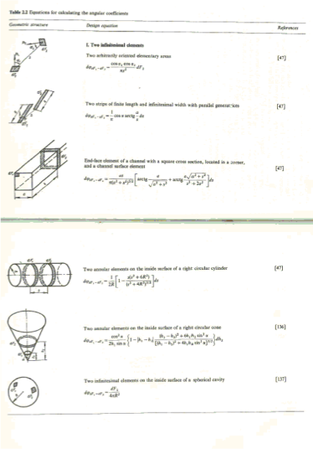
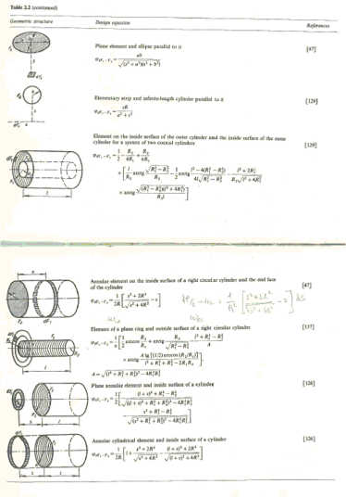
Difficulty: Conductance

Slide 8
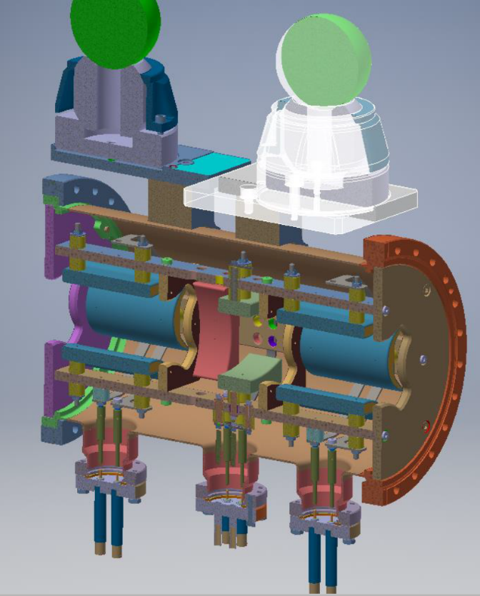
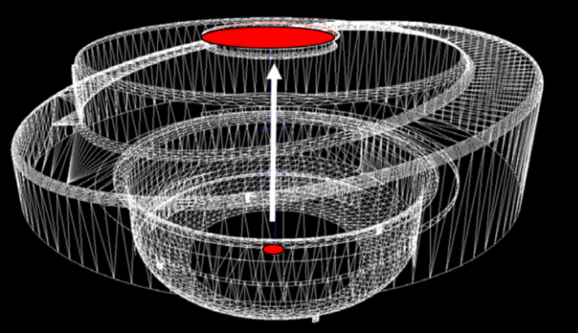

Slide 9
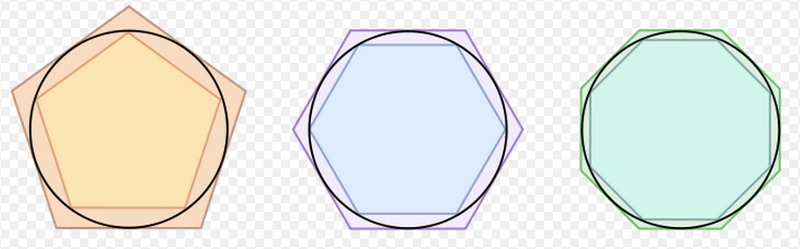
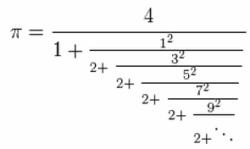


The idea: Monte Carlo method
Circle
R=1
Area=3.14

Slide 10
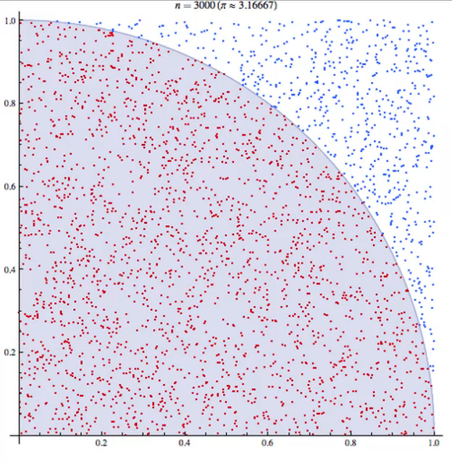
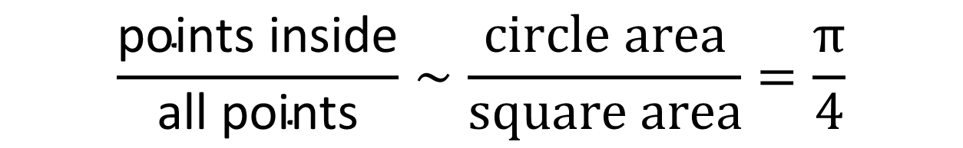
Monte Carlo
$$\frac{\text{points} \text{inside}}{\text{all} \text{points}}∼\frac{\text{circle} \text{area}}{\text{square} \text{area}}=\frac{π}{4}$$

Slide 11
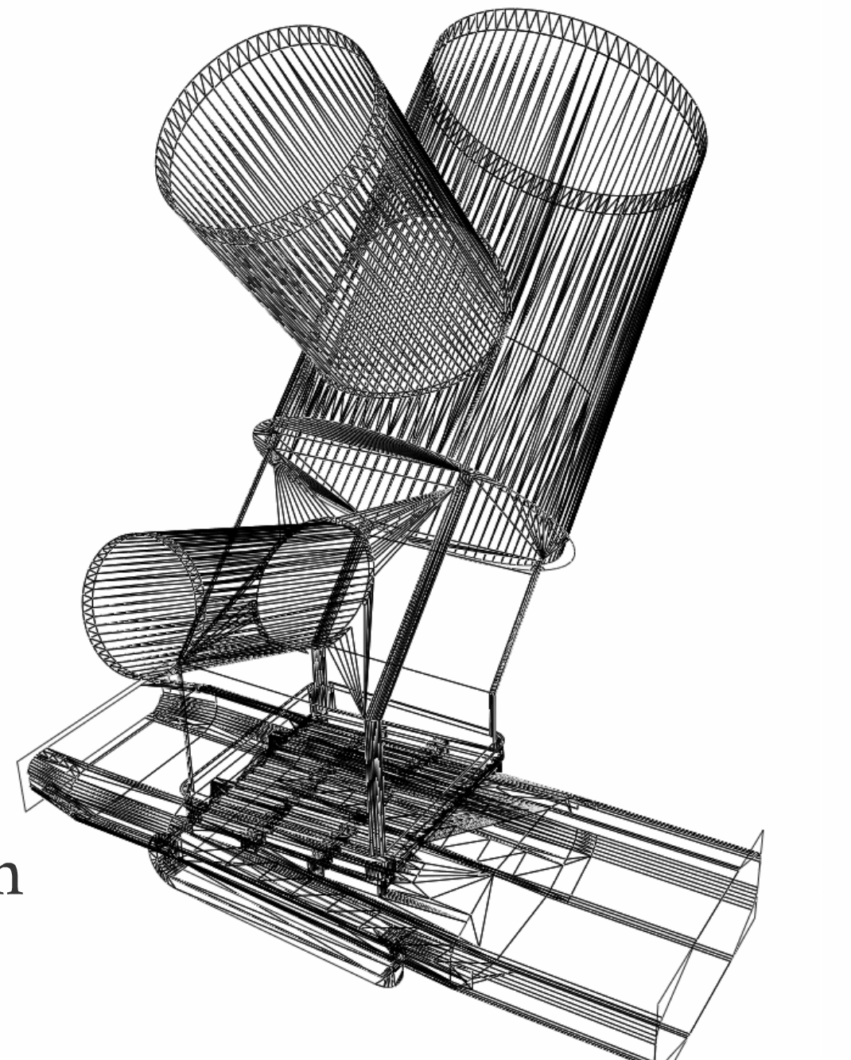
Monte Carlo simulations
Geometry: polygons
Gas input:
pV=NkT
1 Pa*m³/s = 2.4*10²⁰ molecules/s
Virtual / Physical particle ratio

Slide 12
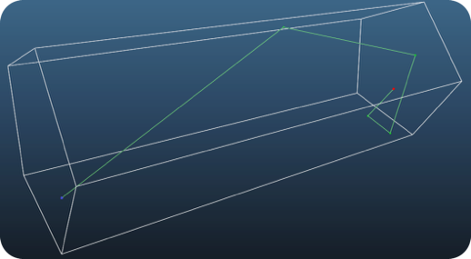
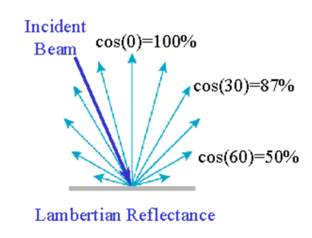
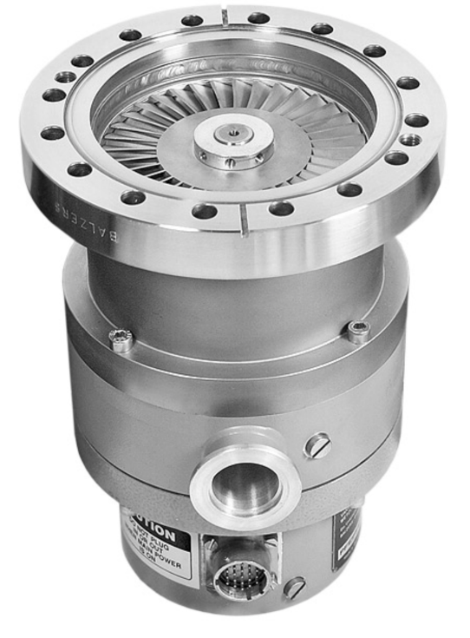
Reflection
Pumping / absorption
S [m³/s] = sticking [0..1] * 1/4 * A [m²] * vavg [m/s]

Slide 13
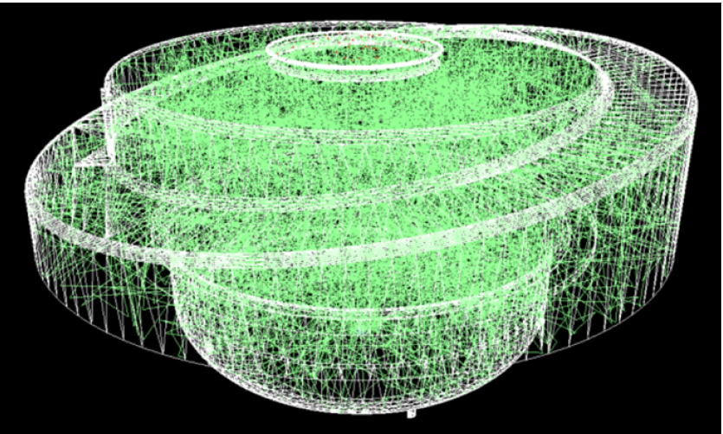
Monte Carlo
Entrance
Exit

Slide 14
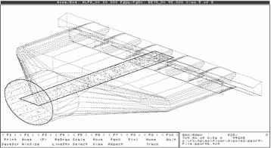
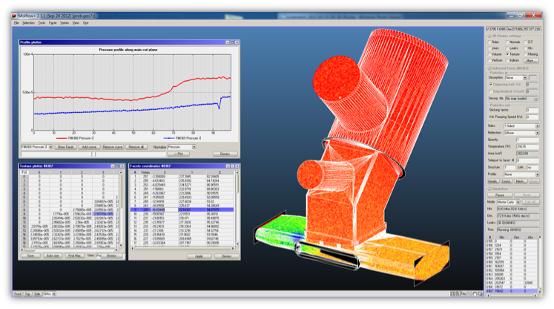
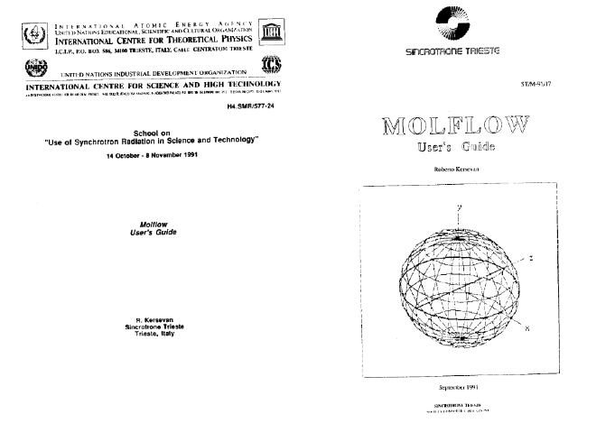

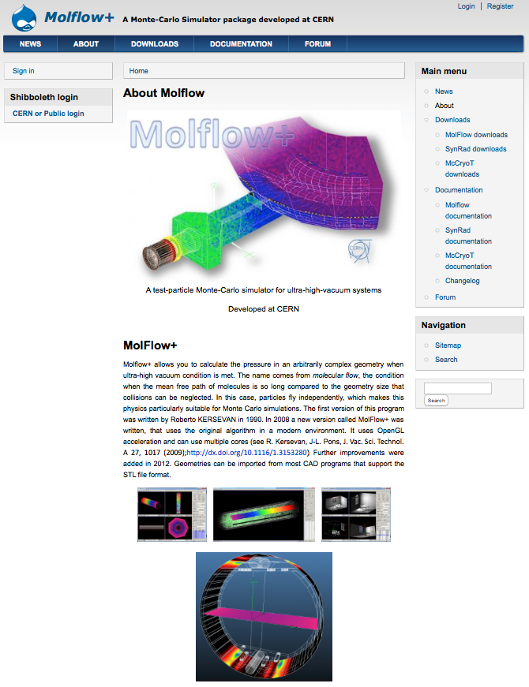
Molflow (1990)
Molflow+ (2008-)
Roberto Kersevan
molflow

Slide 15
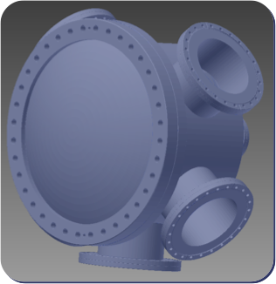
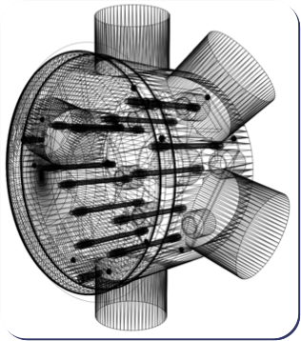
WORKING WITH MOLFLOW
Step 1: creating geometry
CAD
Molflow+
STL format

Slide 16
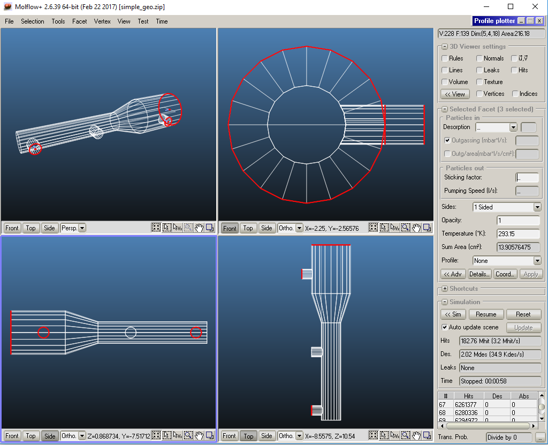
Step 2: adding physics

Slide 17
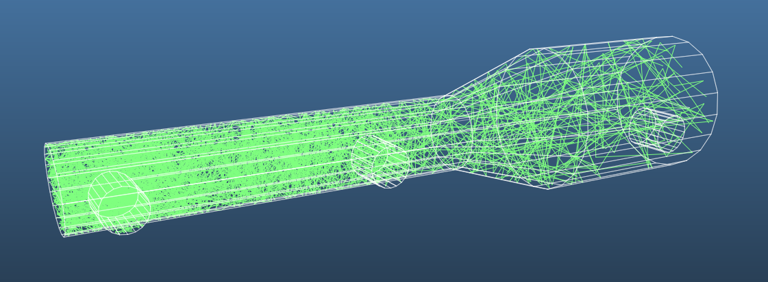
WORKING WITH MOLFLOW
Step 3: simulation and results

Slide 18
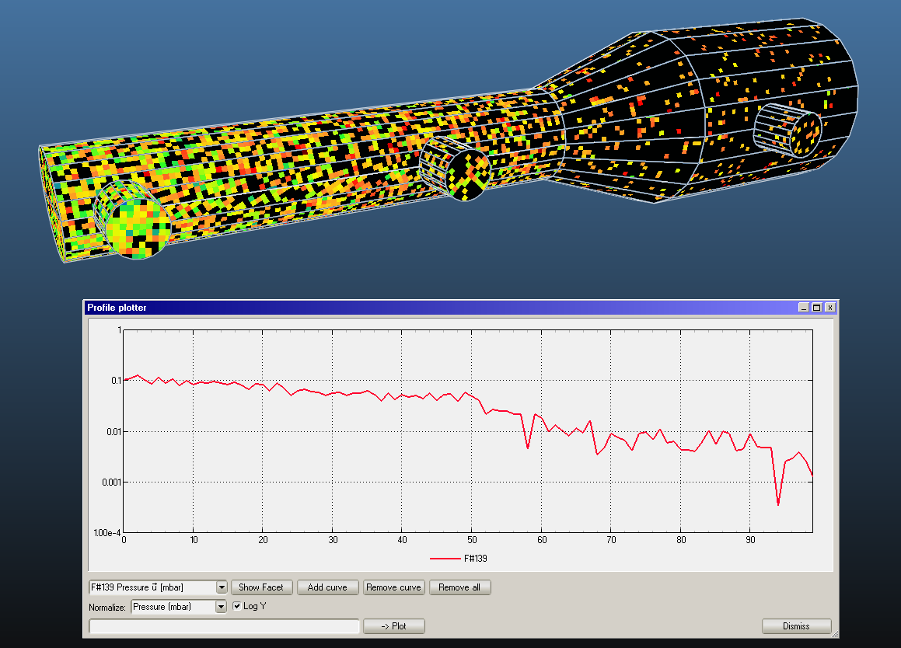
100 molecules

Slide 19
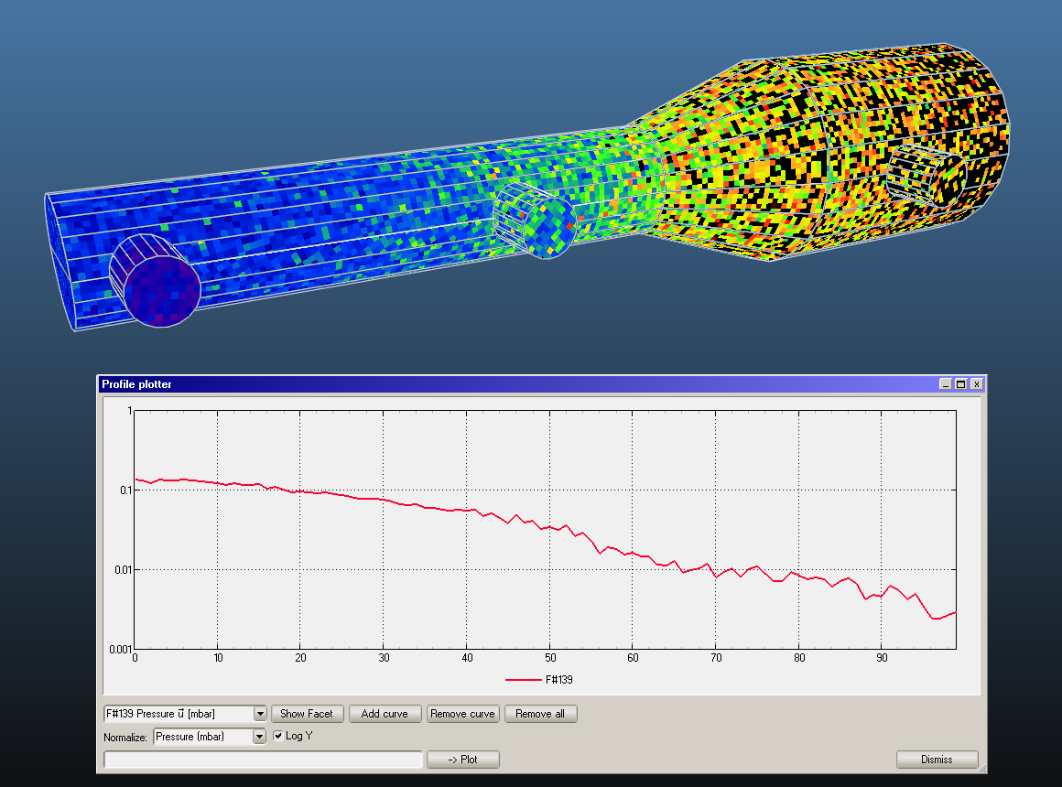
1000 molecules

Slide 20
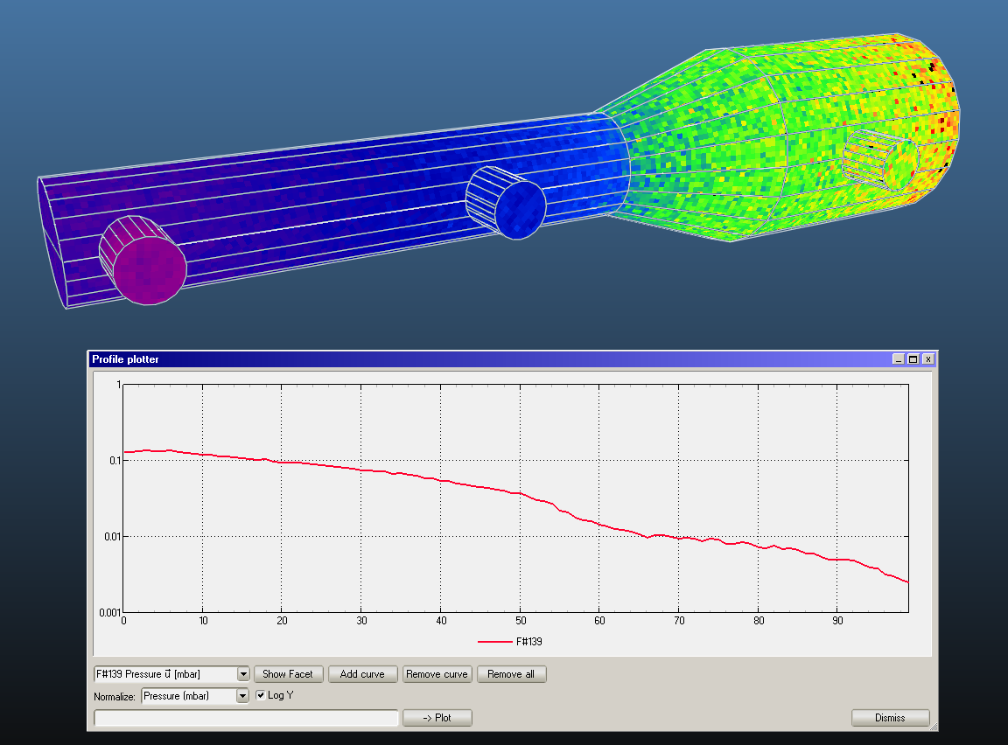
10k molecules

Slide 21
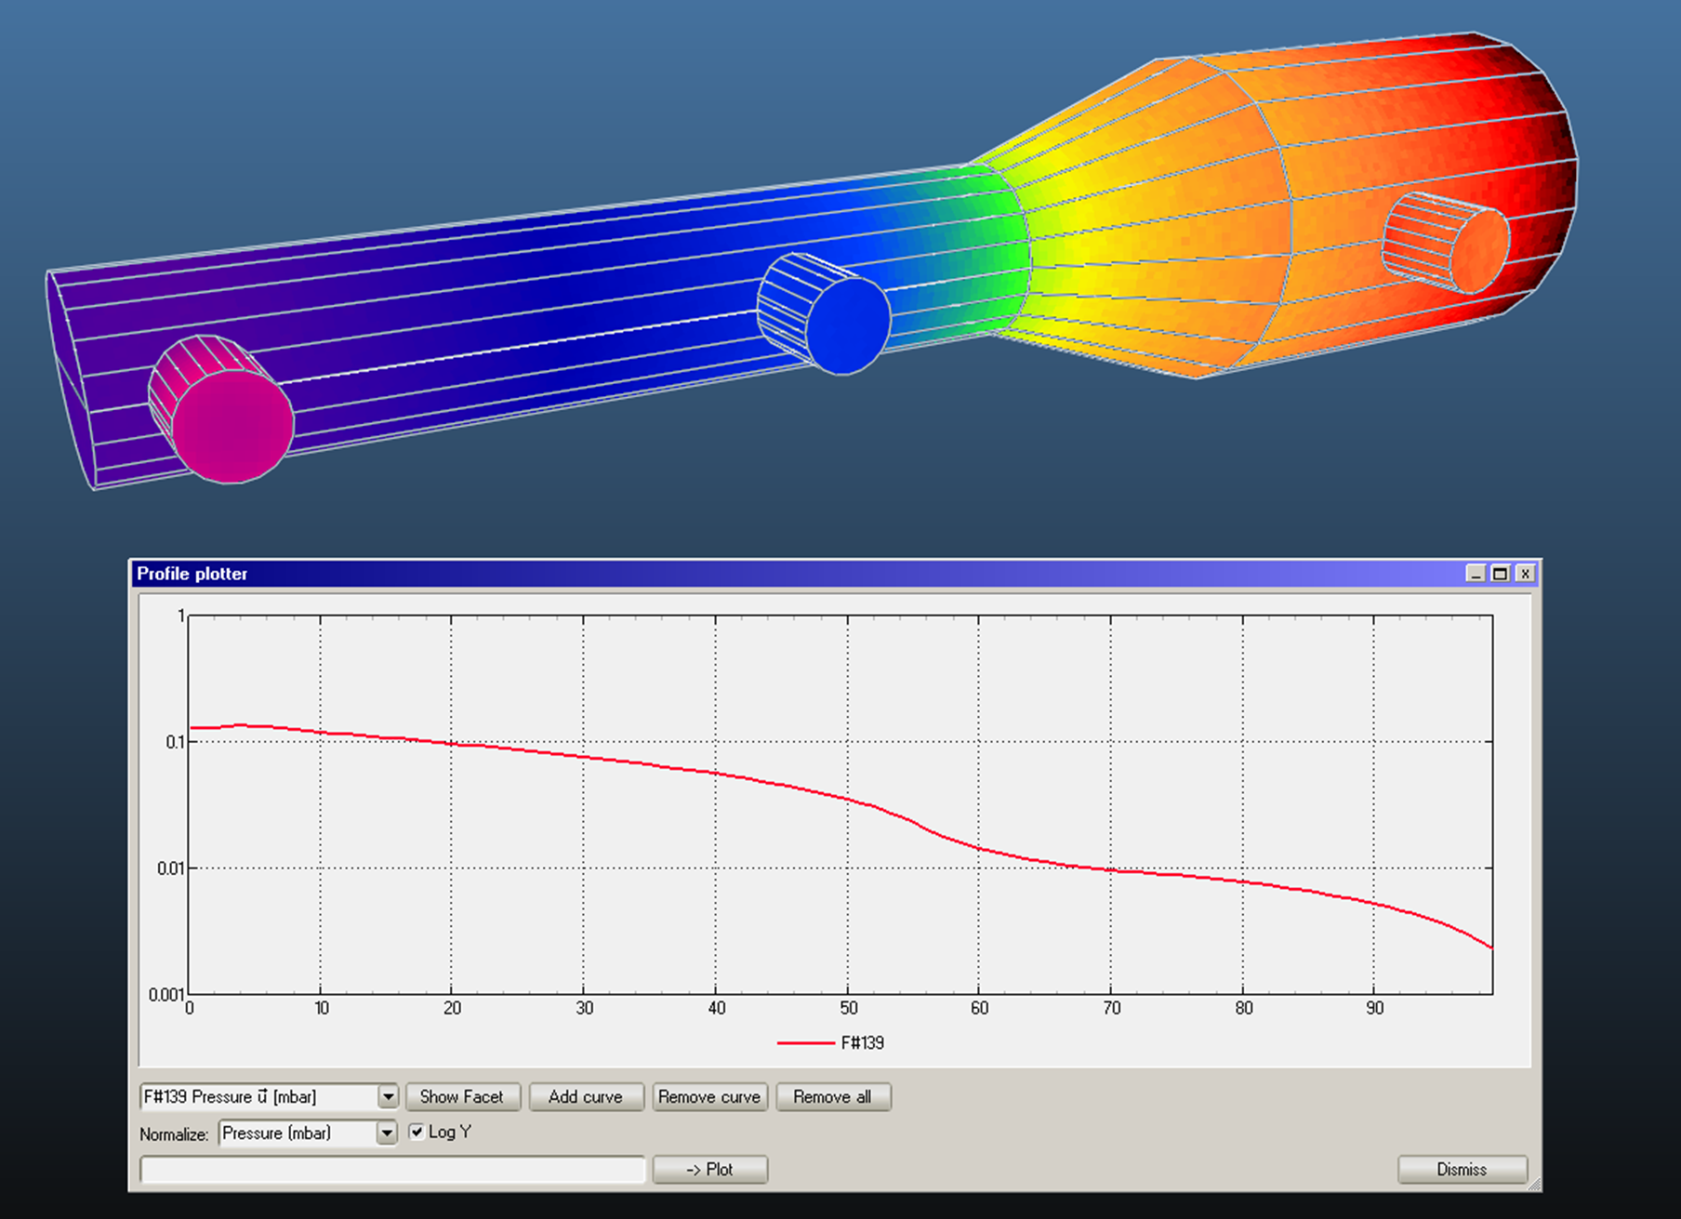
100k molecules

