Slide 1
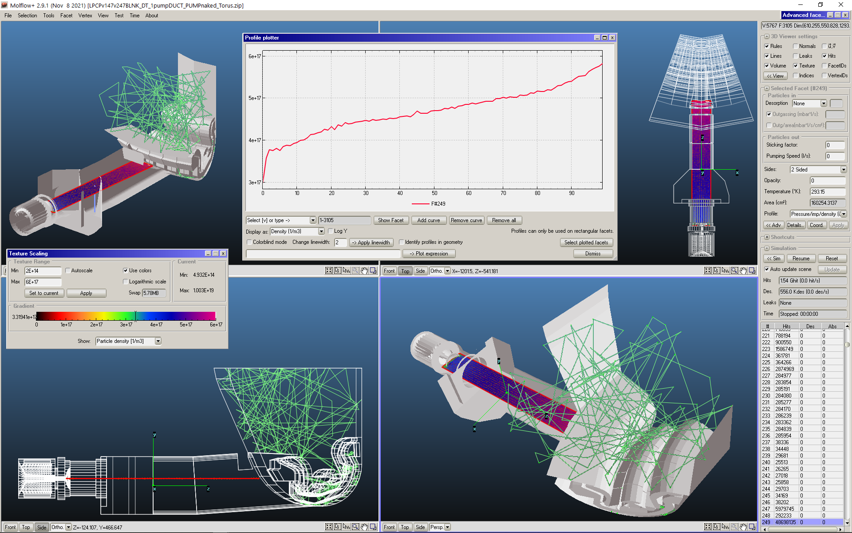
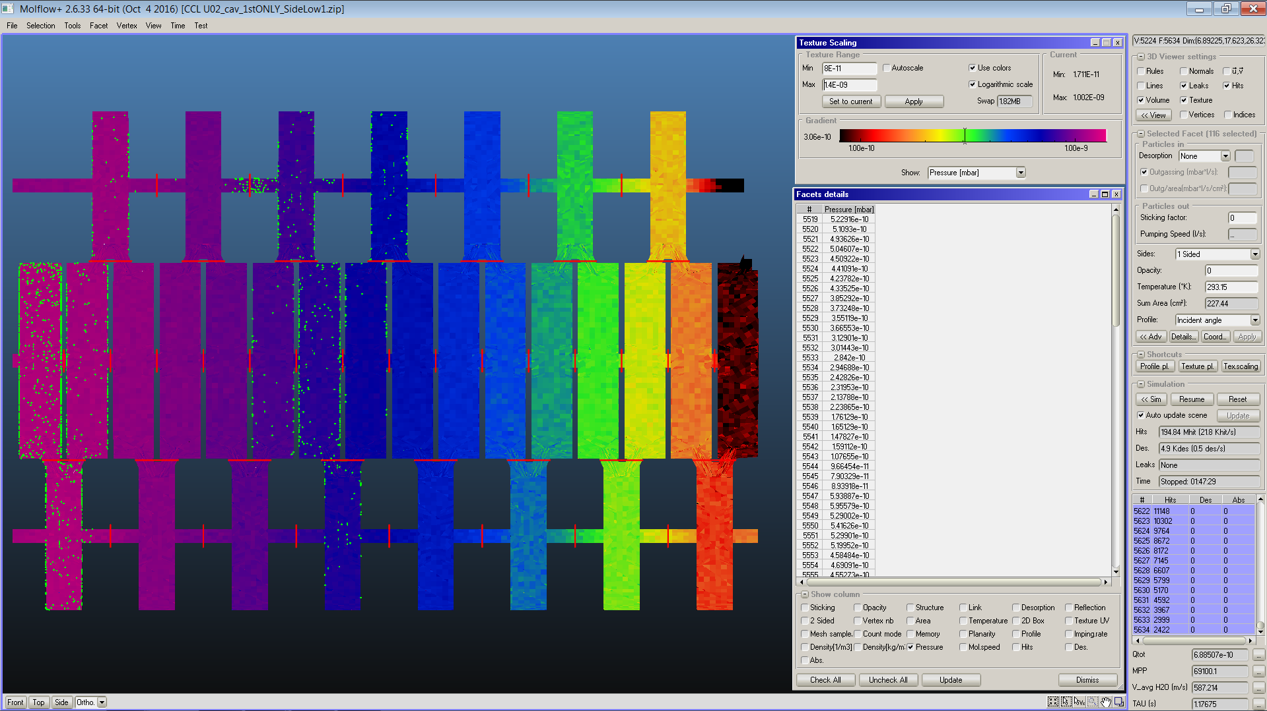
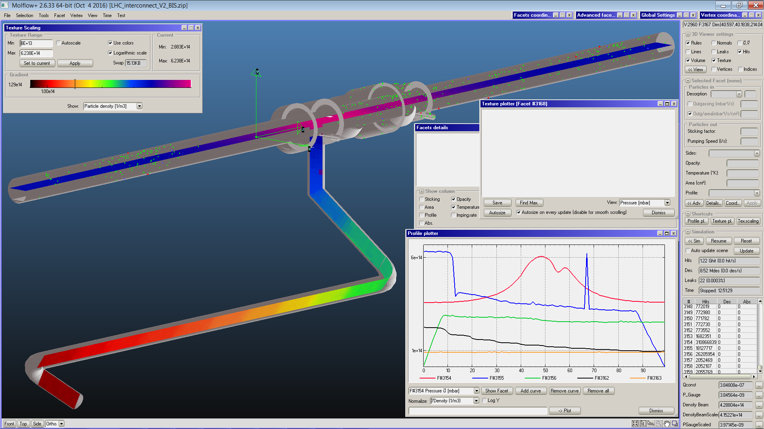
TPMC realization with Molflow+ code
Roberto Kersevan¹
Acknowledging Marton Ady¹, Pascal Baehr²
¹Vacuum Surfaces and Coatings Group, Technology Department, CERN, Geneva, CH
²Presently at Intel, Garching, DE

Slide 2
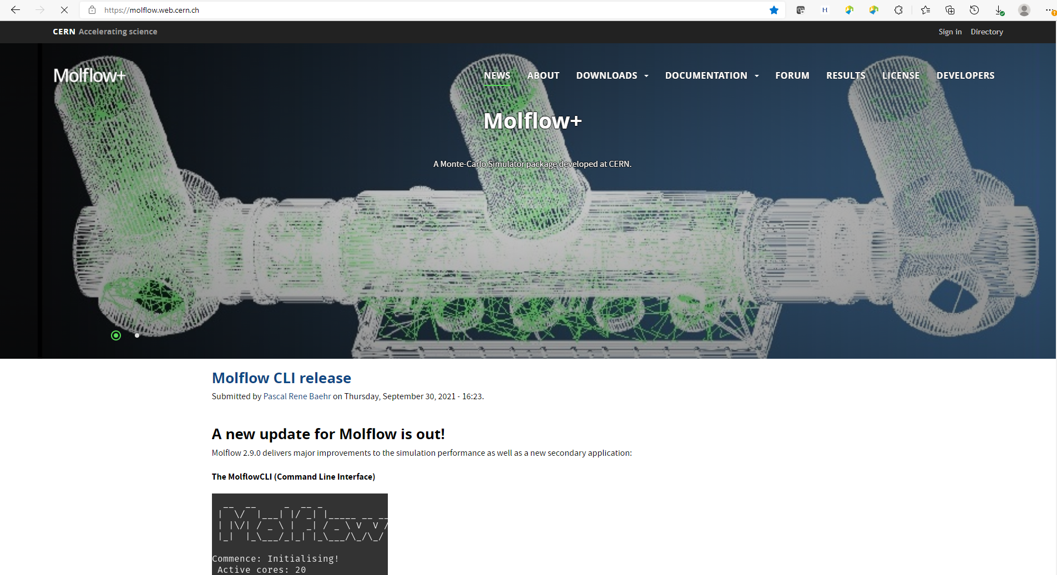
Molflow+ web site: https://molflow.web.cern.ch

Slide 3
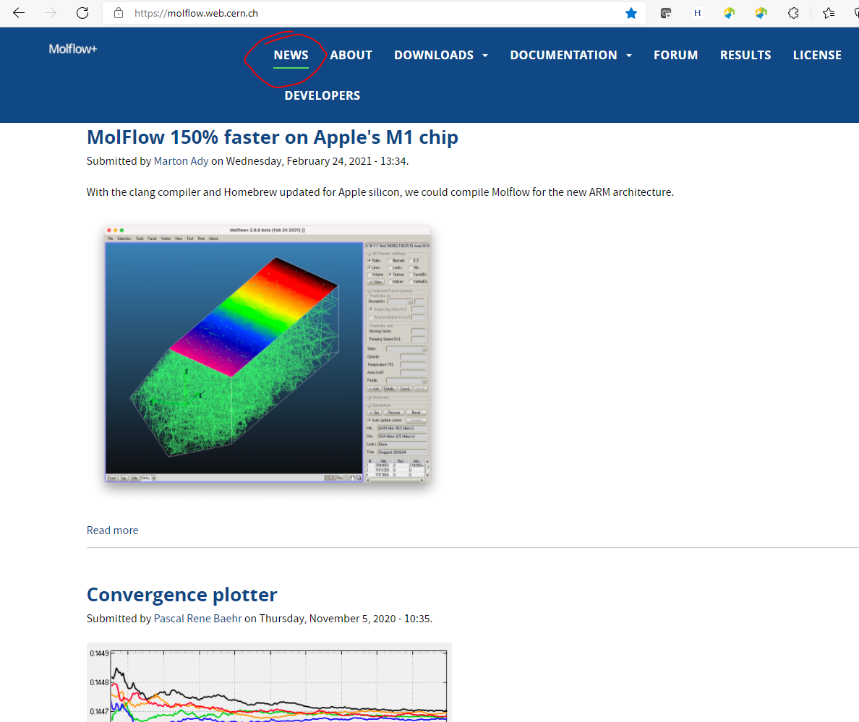
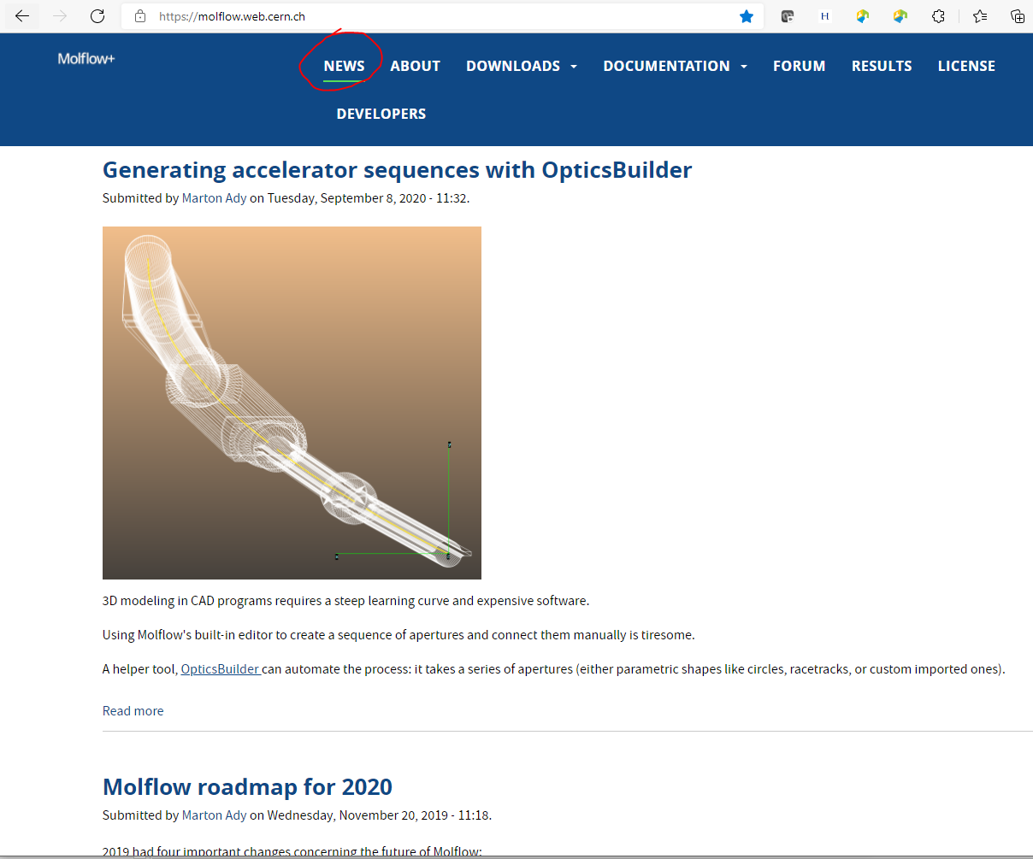
Molflow+ web site: https://molflow.web.cern.ch ; NEWS menu

Slide 4
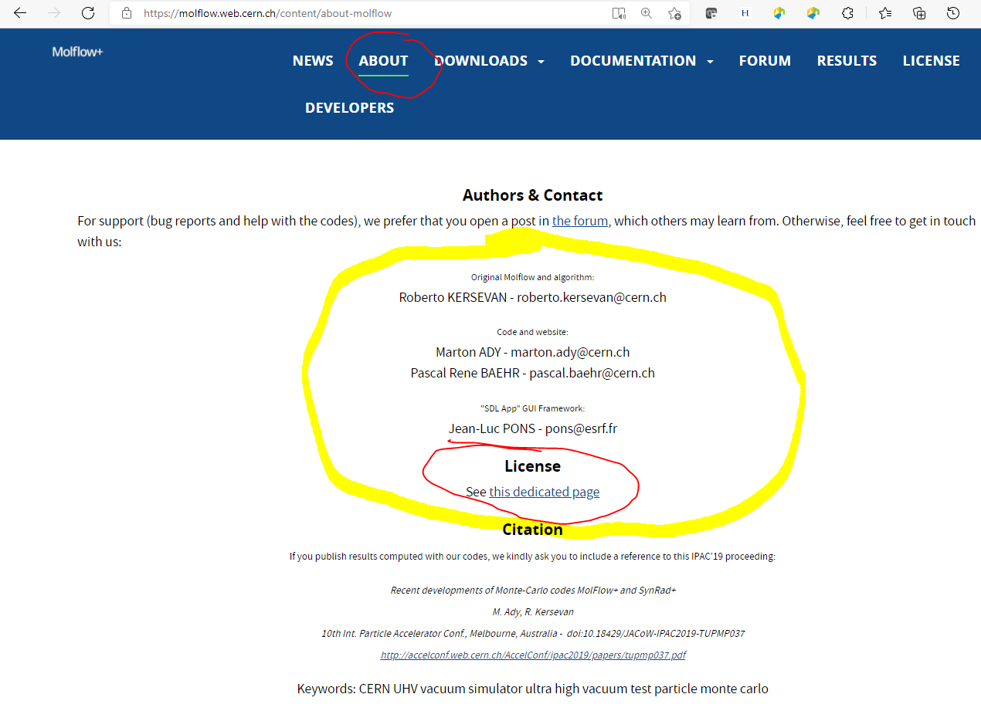
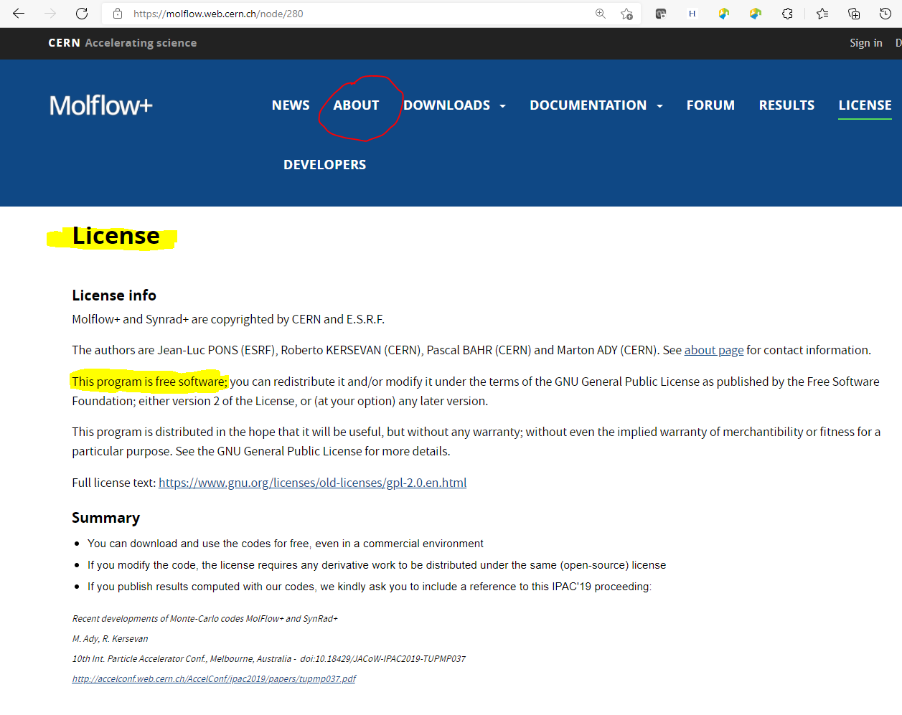
Molflow+ web site: https://molflow.web.cern.ch ; ABOUT menu: authors names and License

Slide 5
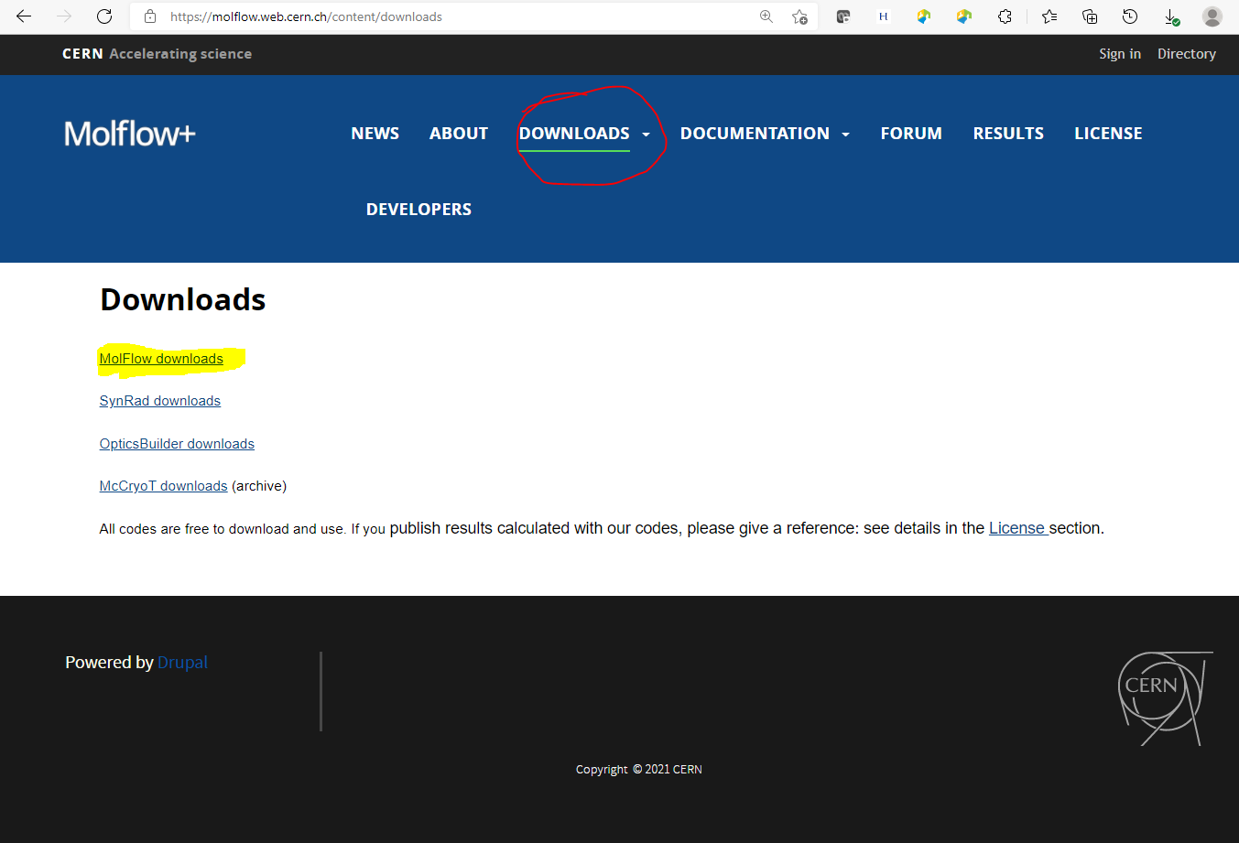
Molflow+ web site: https://molflow.web.cern.ch ; DOWNLOADS menu

Slide 6
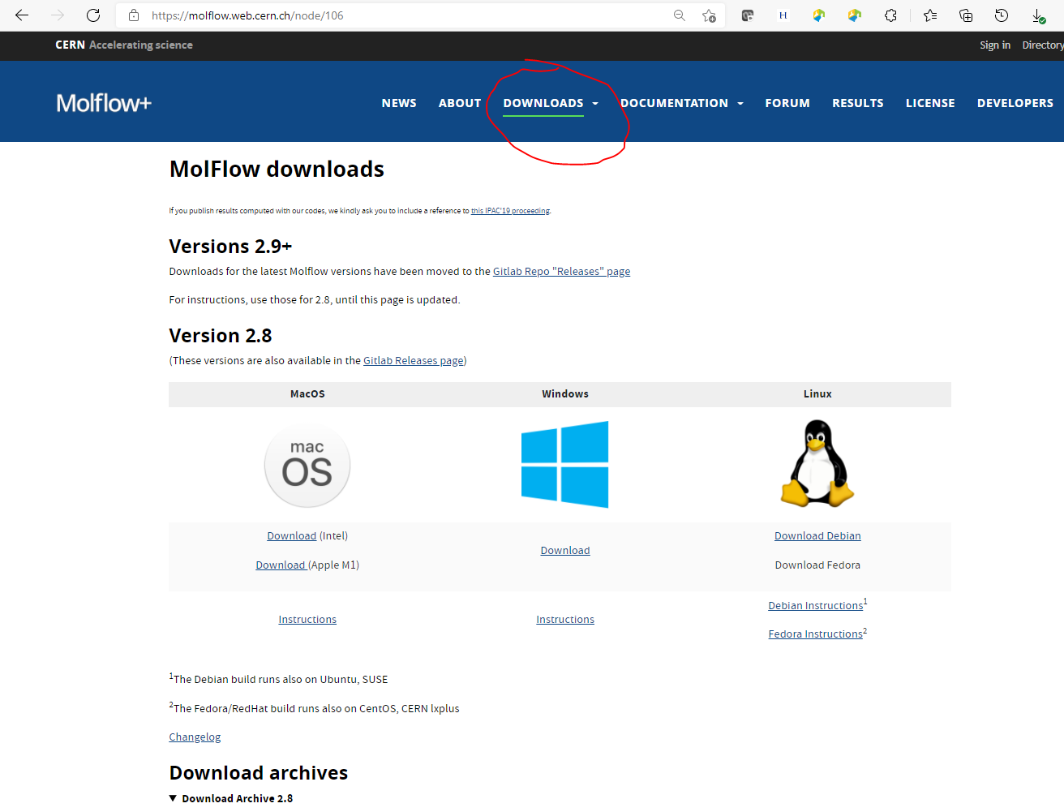
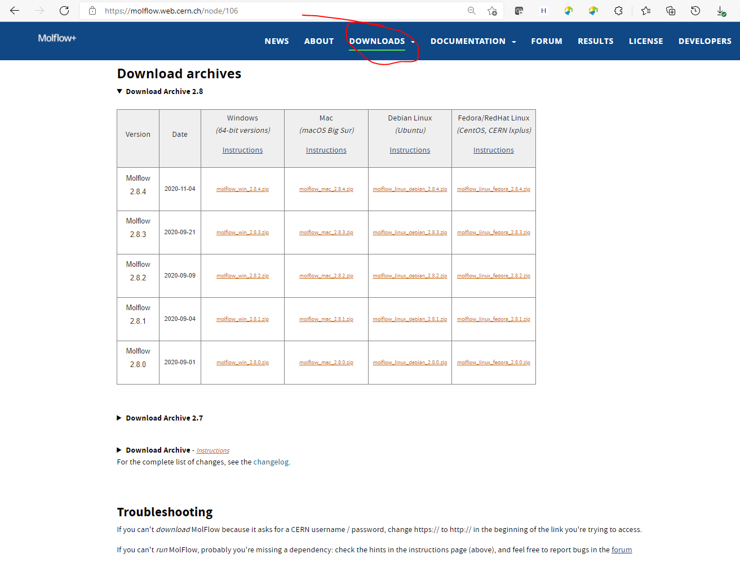
Molflow+ web site: https://molflow.web.cern.ch ; DOWNLOADS menu

Slide 7
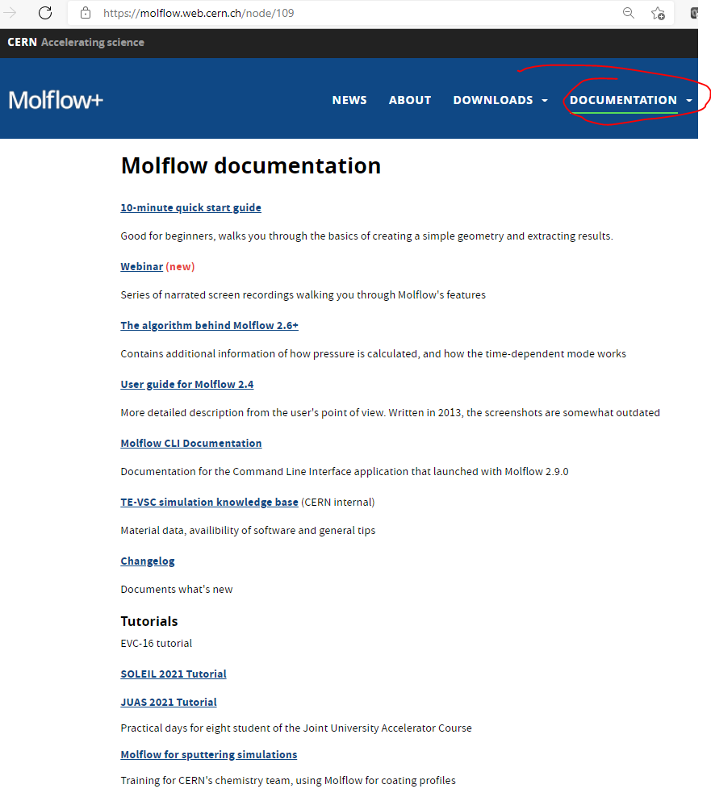
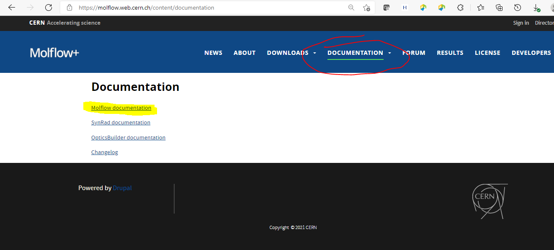
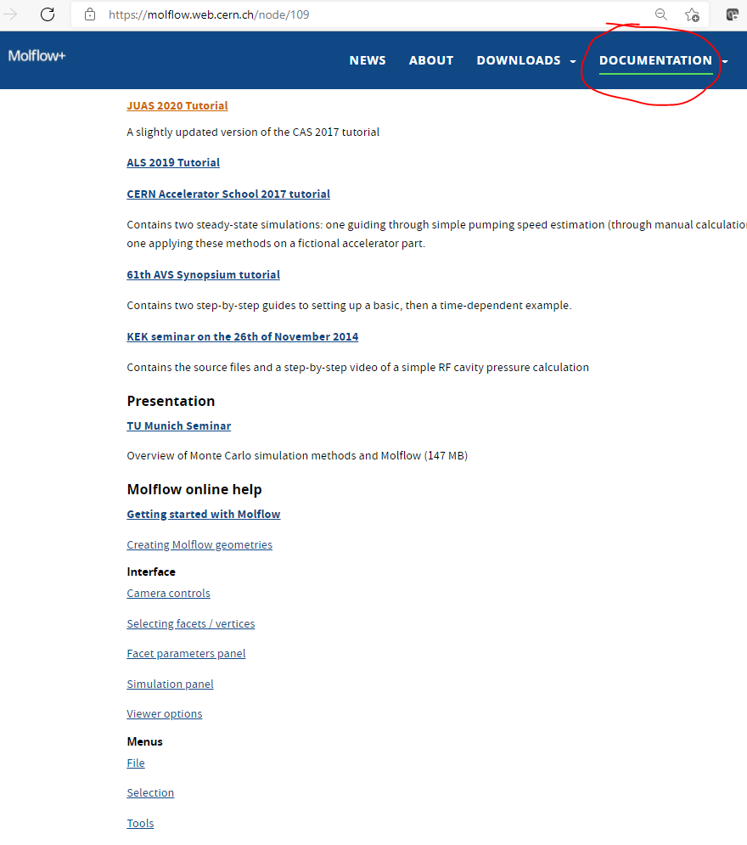
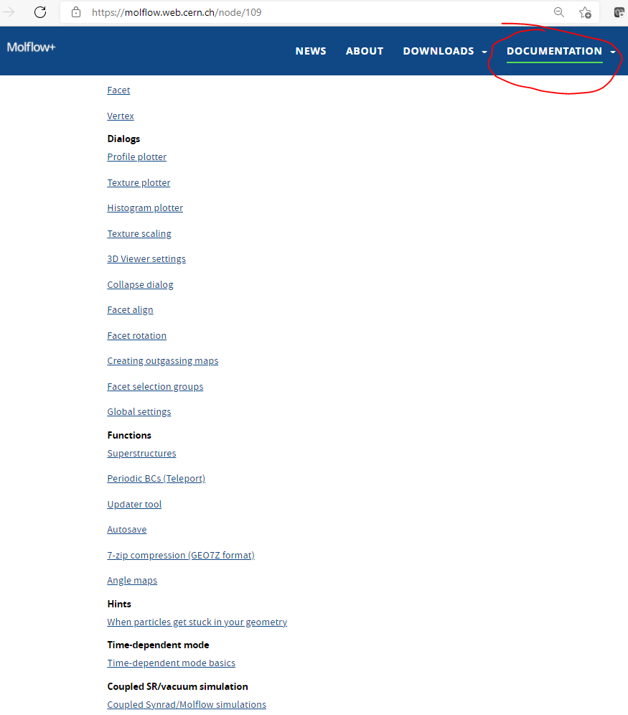
Molflow+ web site: https://molflow.web.cern.ch ; DOCUMENTATION menu

Slide 8
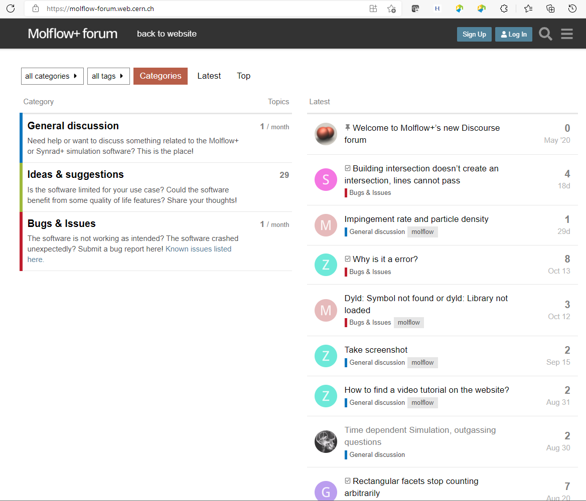
Molflow+ web site: https://molflow.web.cern.ch ; FORUM menu

Slide 9
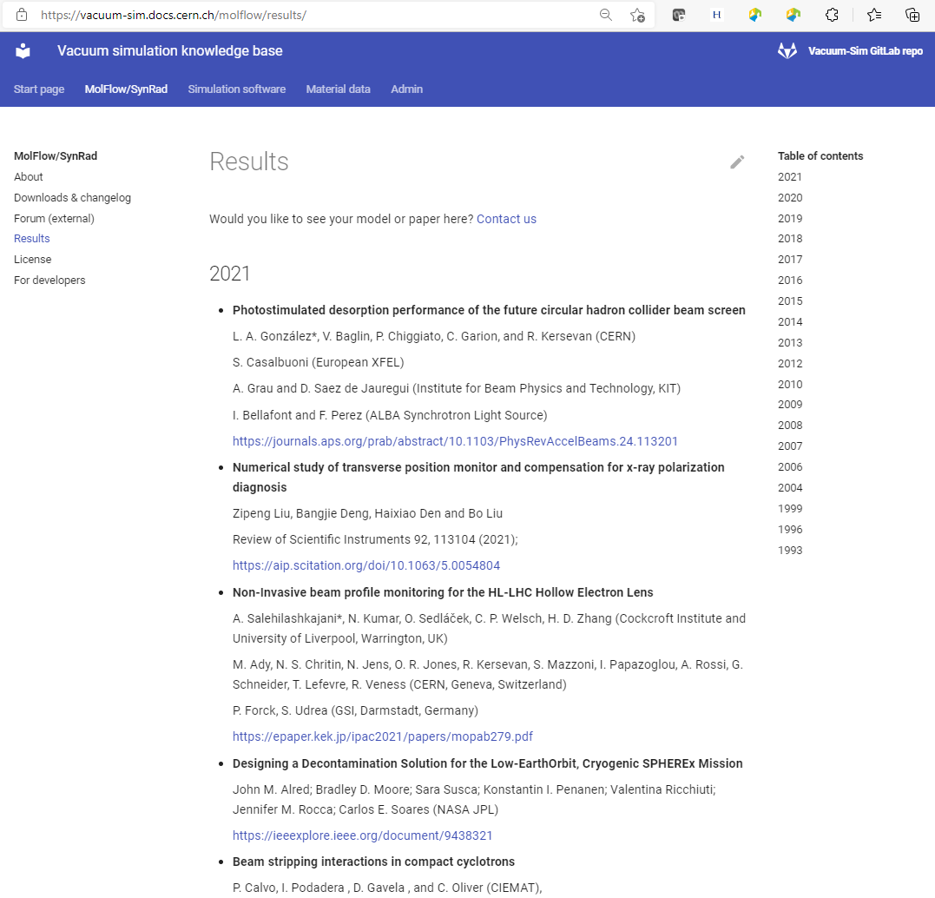
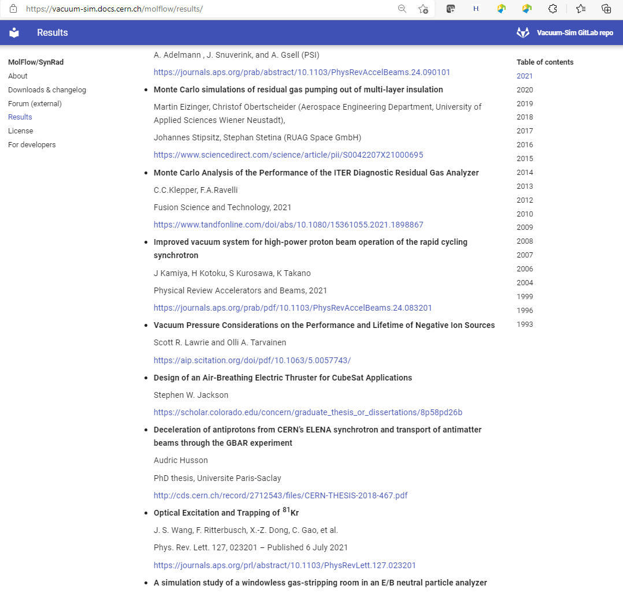
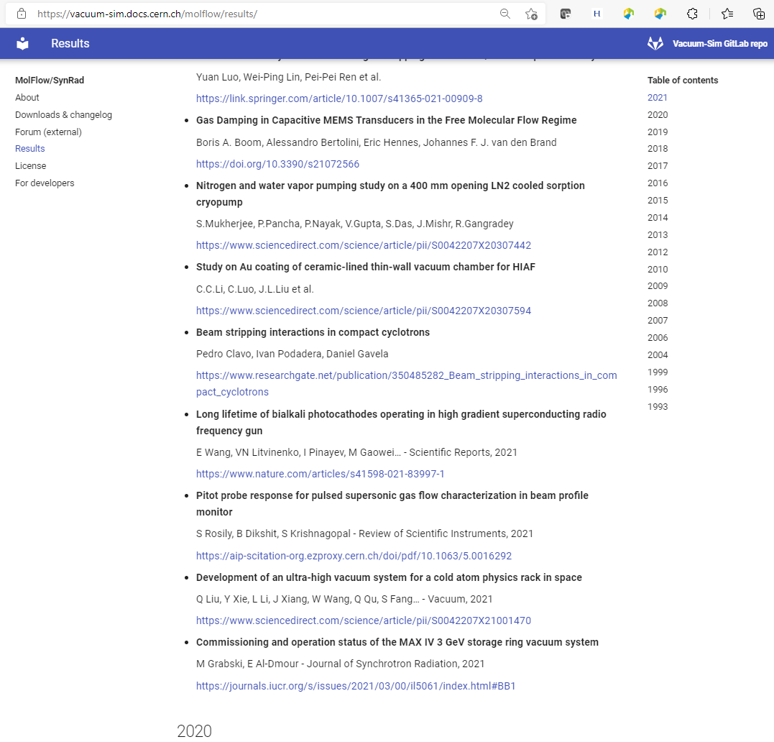
Molflow+ web site: https://molflow.web.cern.ch ; RESULTS menu; 225 Papers listed so far (as of 5/9/23) …

Slide 10
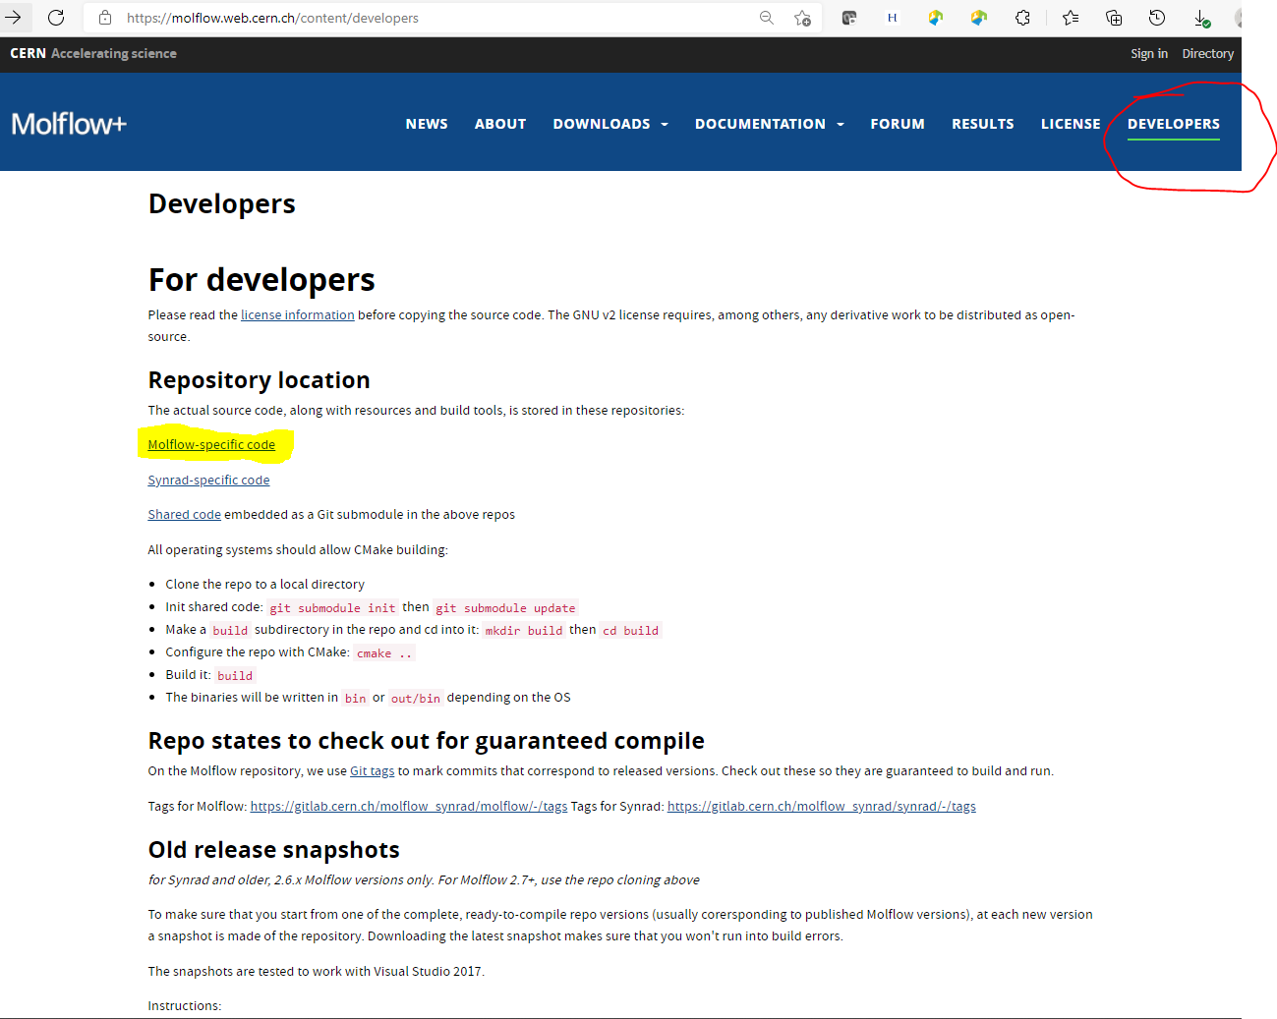
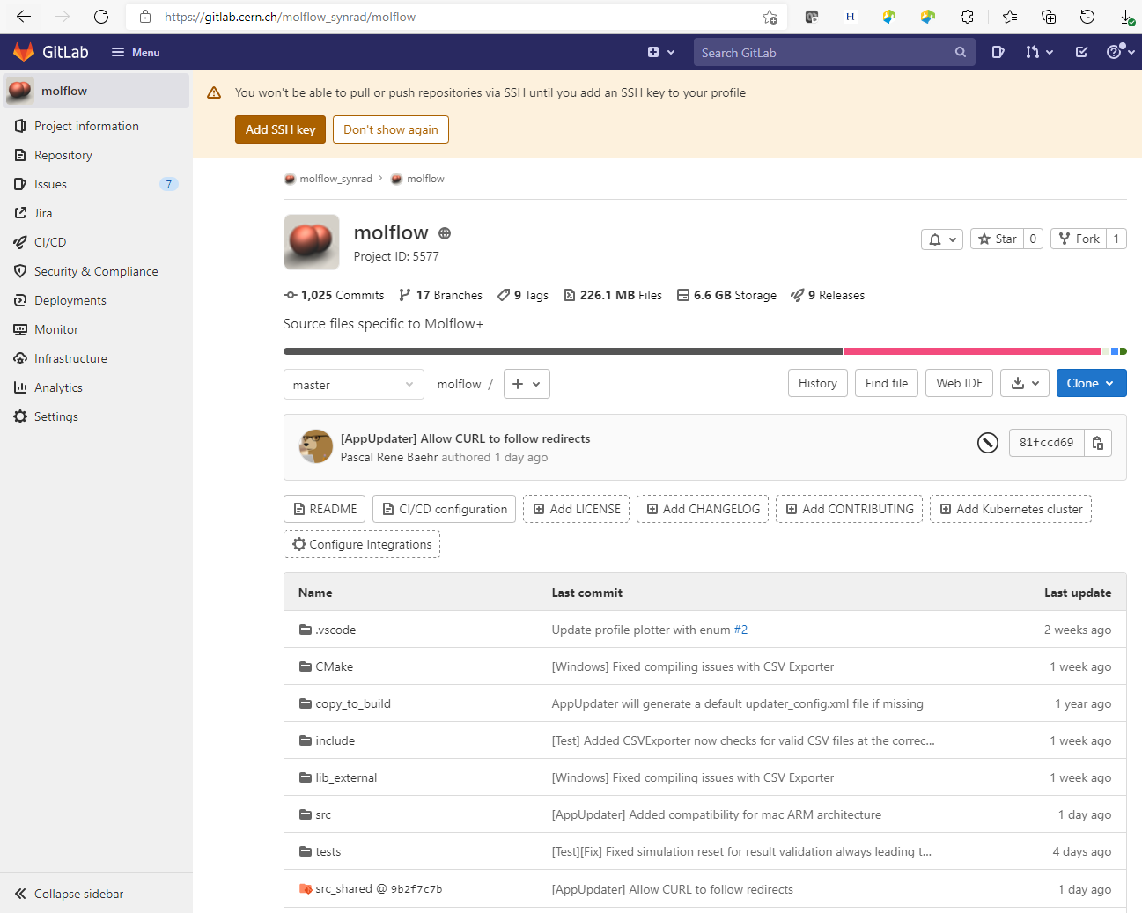
Molflow+ web site: https://molflow.web.cern.ch ; DEVELOPERS menu

Slide 11
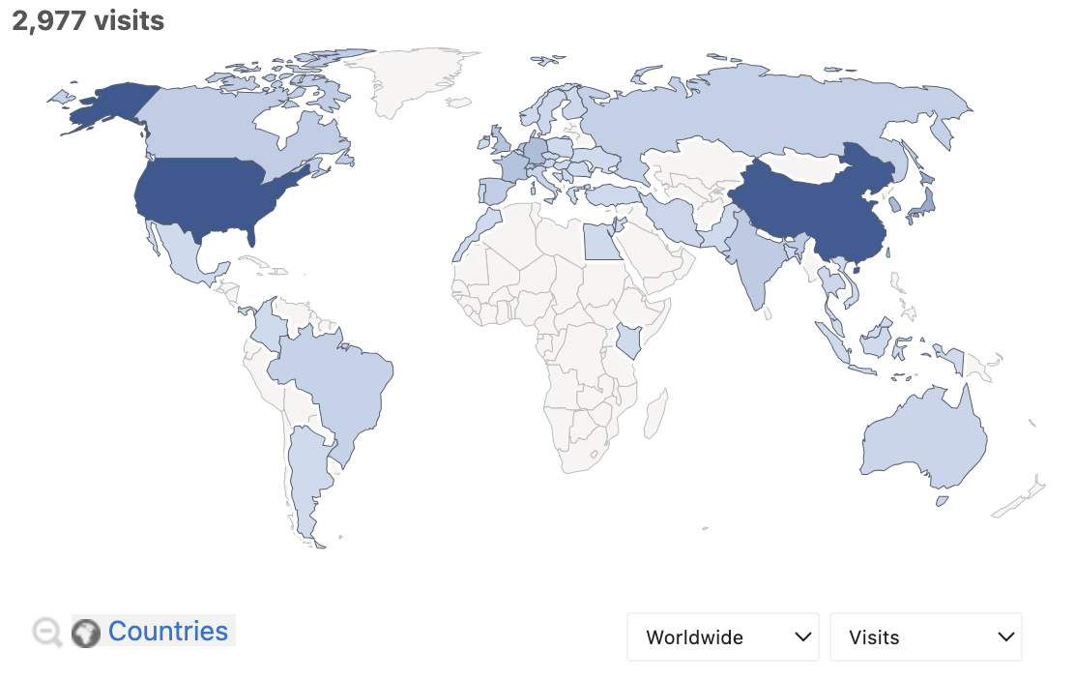
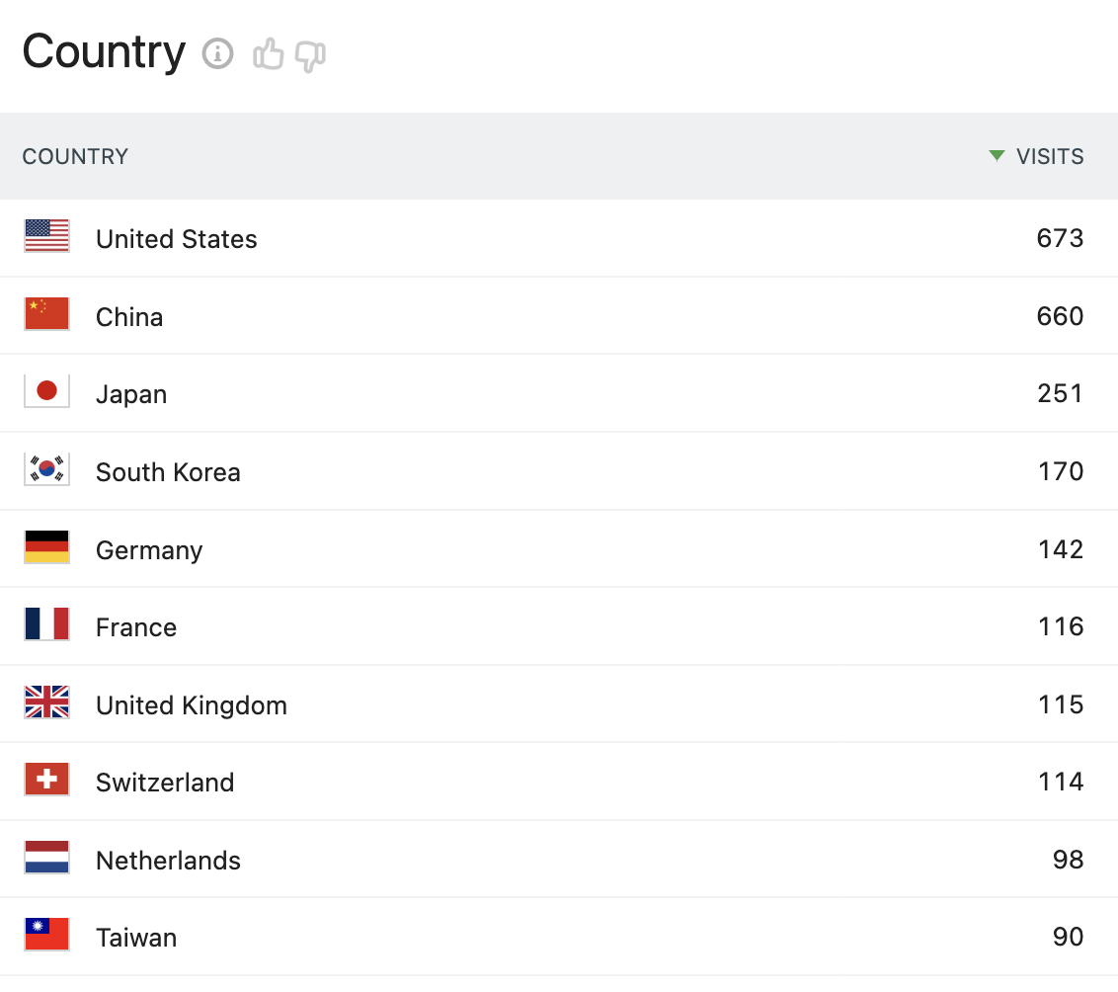
Molflow+ web site: https://molflow.web.cern.ch ; website visits, downloads, and more…
MolFlow+ website visitor statistics (“interested”) 3 months rolling window, June - Sep 2023

Slide 12
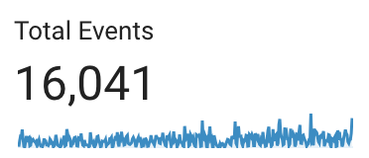
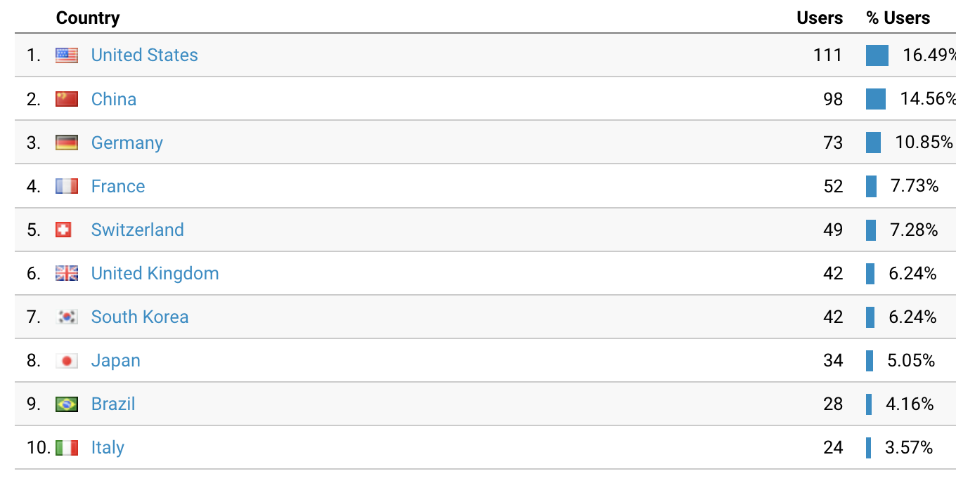
Molflow+ web site: https://molflow.web.cern.ch ; website visits, downloads, and more…
MolFlow+ application launch (“established users”) Only when approved checking for updates, and launched MolFlow+ at lest 3 times 1 year rolling window, June 2022 - May 2023
Launches by OS
14991
629
360

Slide 13
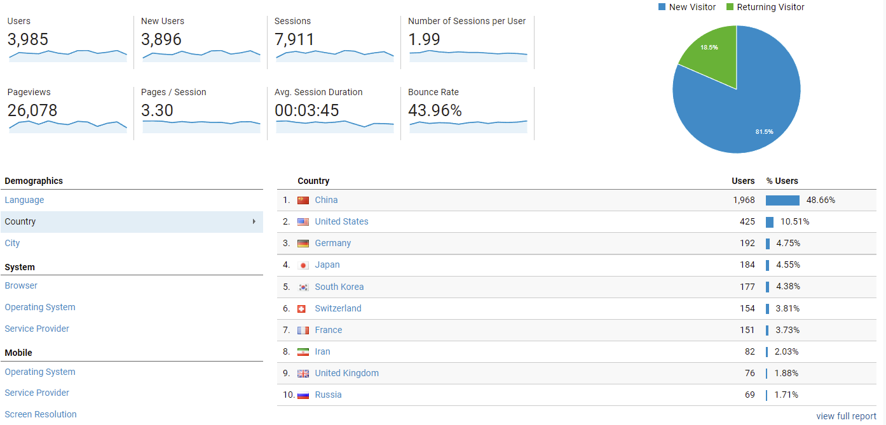
Molflow+ web site: https://molflow.web.cern.ch ; website visits, downloads, and more…
MolFlow+ website visitor statistics (“interested”) 1 year rolling window, Nov 2020 - Nov 2021

Slide 14
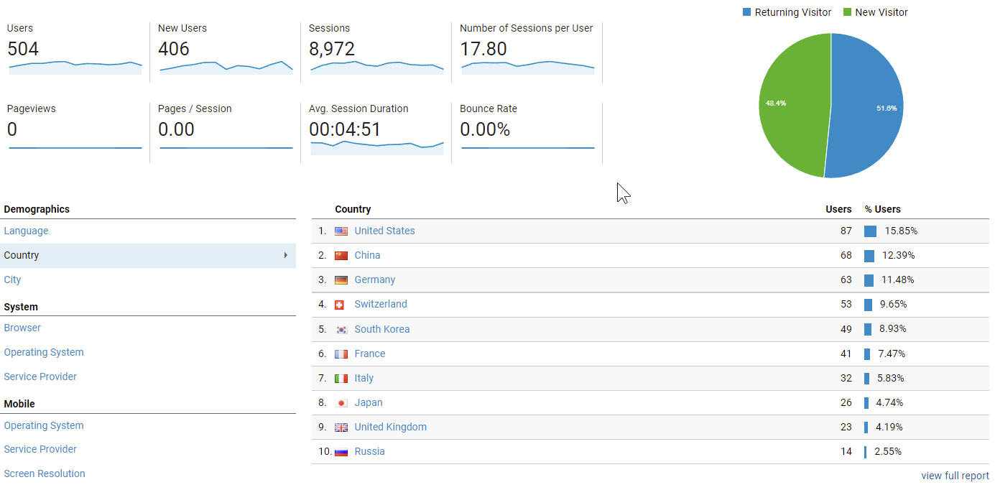
Molflow+ web site: https://molflow.web.cern.ch ; website visits, downloads, and more…
MolFlow+ application launch (“established users”) Only when approved checking for updates, and launched MolFlow+ at lest 3 times 1 year rolling window, Nov 2020 - Nov 2021

Slide 15
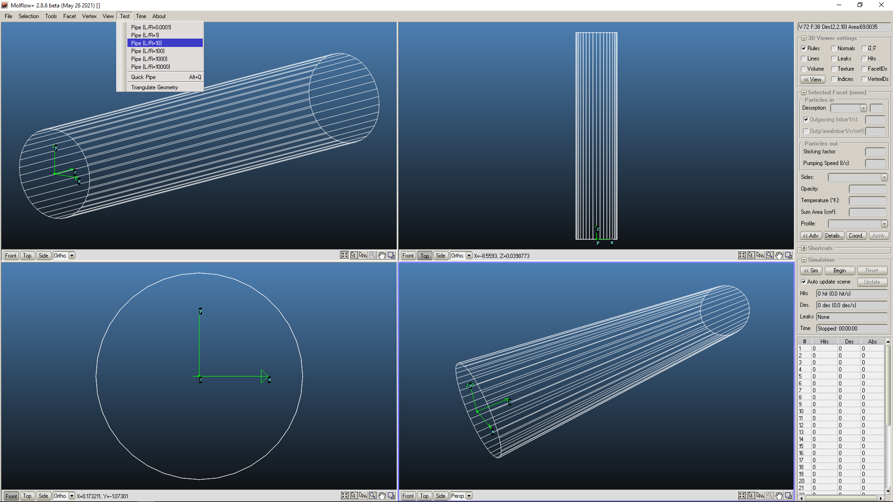
Molflow+: Running the program; Example 1: L/R=10 tube, 1 cm radius, 36 side facets

Slide 16
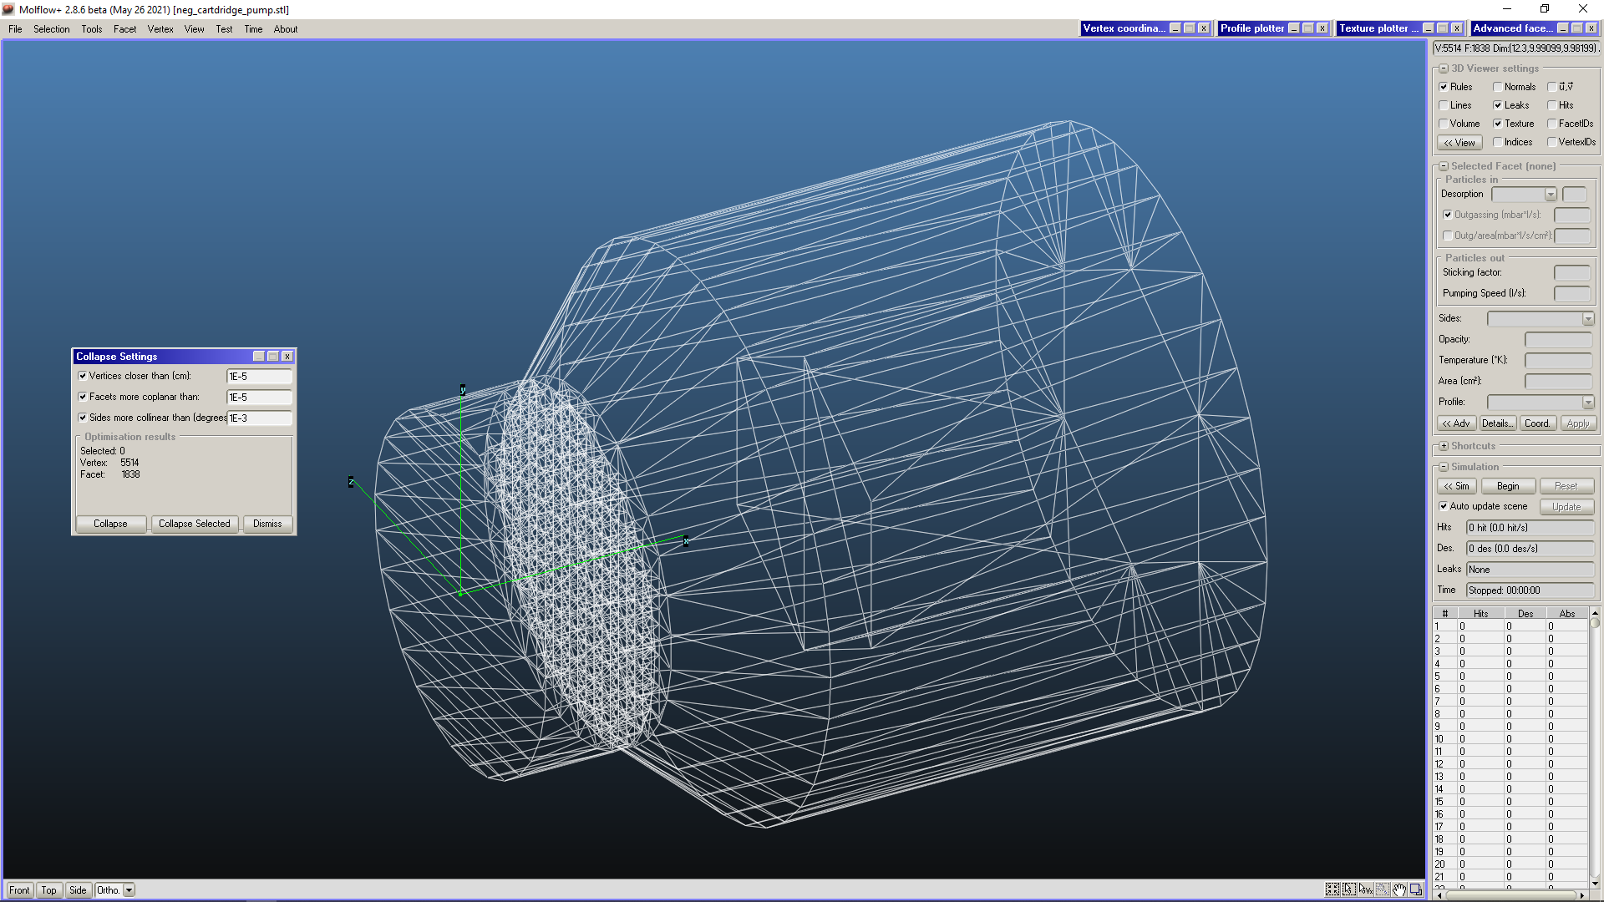
Molflow+: Running the program; Example 2: NEG pump inside a pumping dome, with slotted wall (see leaflet)

Slide 17
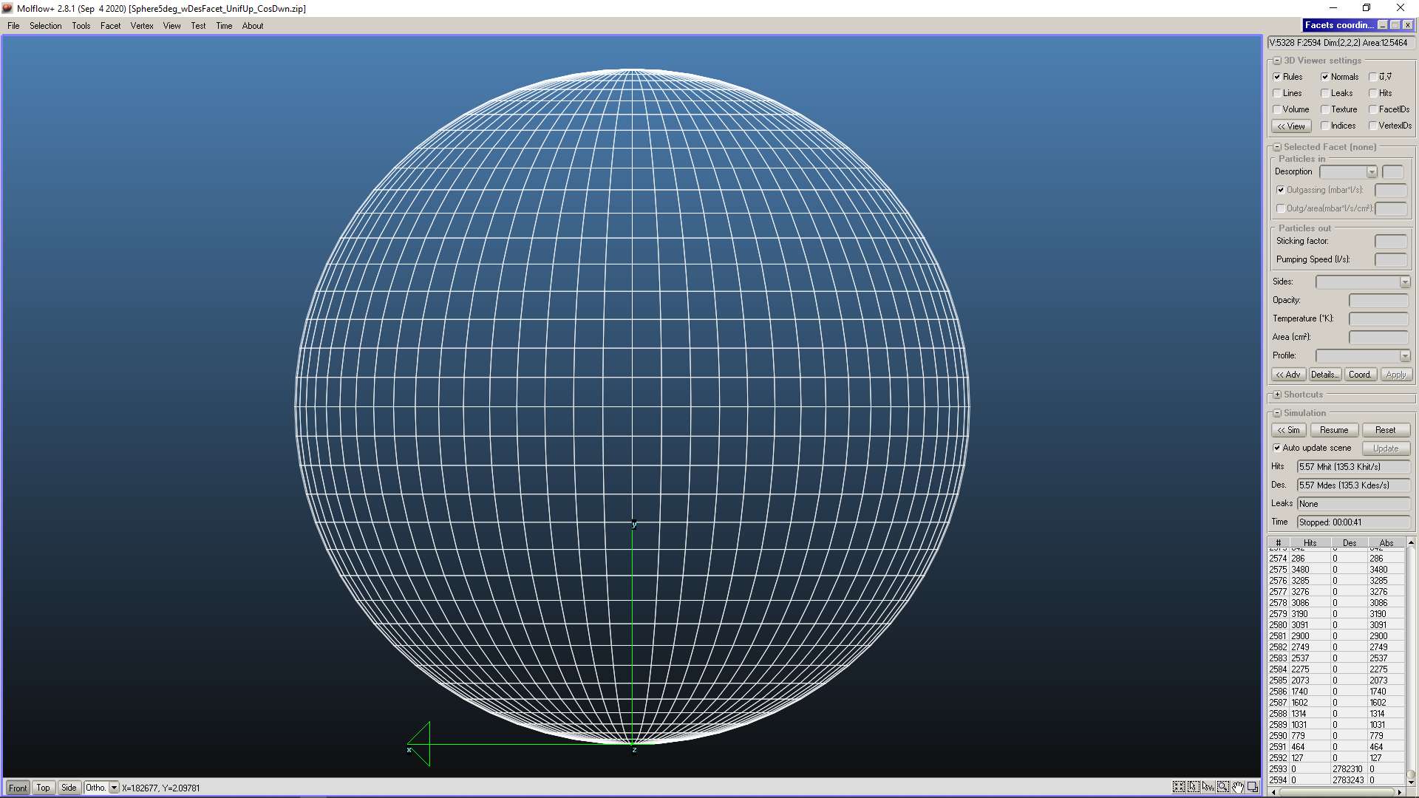
Molflow+: Running the program; Example 3: sphere with desorption facets in the middle: angular distribution

Slide 18
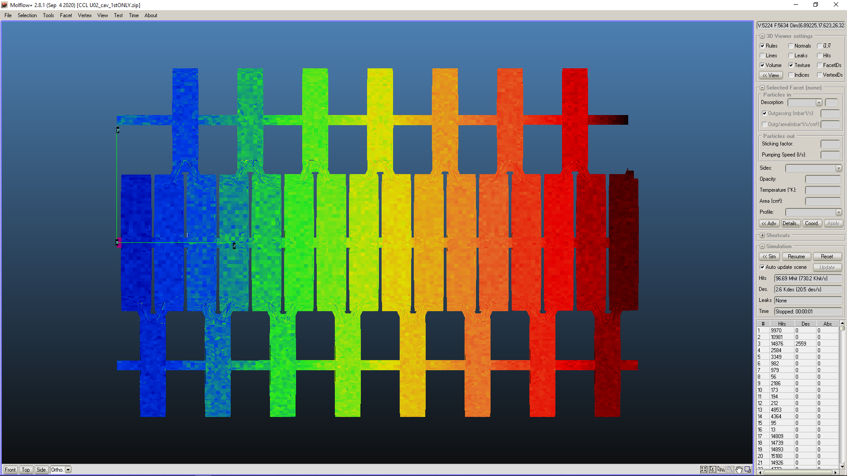
Molflow+: Running the program; Example 4: multi-cell radiofrequency cavity

Slide 19
Molflow+: Running the program; Example 5: one sector ITER vacuum chamber (lower half) with pumping duct and cryopump (1 of 9 40° sectors)

