Slide 2
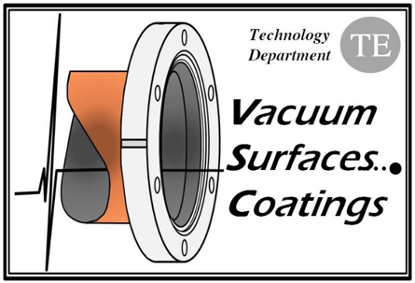
THE TEST-PARTICLE MONTE CARLO METHOD AND ITS IMPLEMENTATION IN THE MOLFLOW+ CODE
R. Kersevan, CERN/TE-VSC-VSM
Acknowledging M. Ady, P. Baehr, CERN/TE-VSC-VSM
Outline:
The Test-Particle Monte Carlo algorithm as implemented in Molflow+;
(Some) program menus and commands;
File formats: txt, stl, geo, xml: why and what;
Transmission probability and conductance;
Simulating pumps;
Pressure, angular and density profiles: how to get the most out of them;
Textures: how to implement them and how to use them; memory management;
Optimizations: multi-structured models, teleportation; taking advantage of symmetry axis and planes, speed optimization;
Time-dependent simulations: what you can do and what you can't (yet); Time-dependent parameters;
Non-isothermal models;
Radiometric and thermal transpiration effects;
Moving surfaces: Parallel moving and rotations;
Review of applications of Molflow+ to non-vacuum phenomena (only if time allows);
Material can be downloaded also from:
https://molflow.web.cern.ch/node/405
→ Please download on your computer the latest beta version from the CERN web site AND BRING A MOUSE! ←

Slide 3
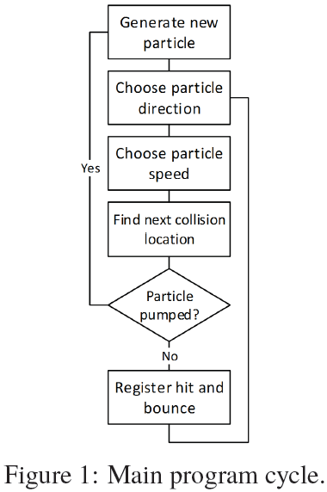
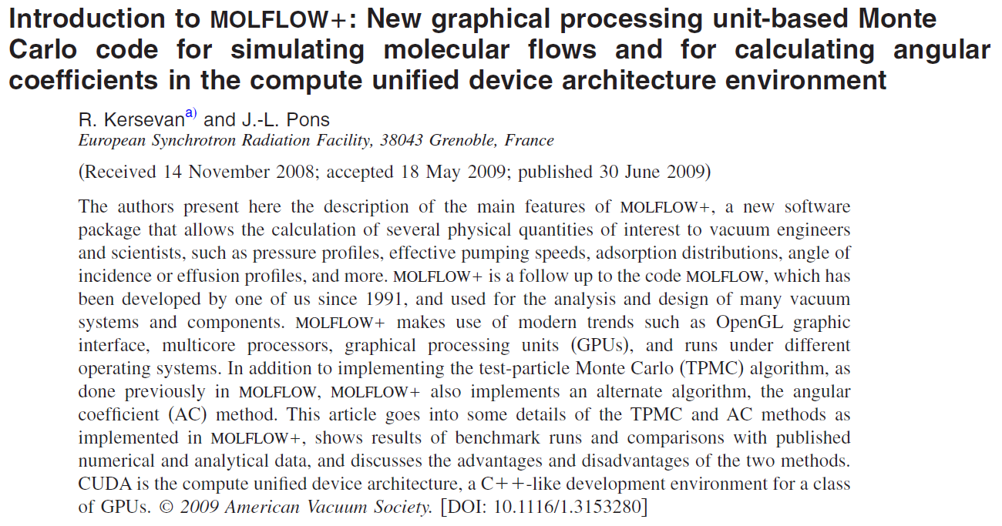
1) The Test-Particle Monte Carlo algorithm as implemented in Molflow+;
(Ref.: CERN document “The algorithm behind Molfow+”, M. Ady, R. Kersevan, CERN, April 2015)
Development of Molflow (DOS version) starts in the late 80s: Turbo Pascal under DOS
Modern version, C/C++ under Windows, 2009 (with J.-L. Pons, ESRF)
Major upgrades since 2012 (with M. Ady, now CERN staff)
3D model or the vacuum system is created, using planar polygons
Valid in molecular flow conditions only! No molecular collisions yet
Single-gas simulation, plan to go to multi-gas but no time to implement it yet
Event-driven rather than time-driven:
rays representing the molecules’ trajectories (no gravity) are
traced from facet to facet, and then the time when a collision
takes place is calculated retrospectively
most codes use time-driven simulations

Slide 4
1) The Test-Particle Monte Carlo algorithm as implemented in Molflow+;
The ray-tracing routine: simple matrix multiplication and trigonometry

Slide 5
1) The Test-Particle Monte Carlo algorithm as implemented in Molflow+;
Advantage of event-driven simulation:
Speed: the next collision location is determined by ray tracing methods, not by calculating the new location and checking if it’s still inside the geometry
Continuity: when a particle is pumped, a new one can be generated: with this, pressure results are immediate, and precision gets better with longer simulation time
Low memory requirement: at a certain moment, only a few particles (usually equal to the number of processor cores) are traced
Advantage of time-driven simulation:
By inserting particles to any location, arbitrary initial states can be modelled
Straightforward to measure volumetric quantities (gas density, prevailing molecule direction)
Relatively easy to add inter-molecular collisions to the code
As time advances in small steps, it is relatively easy to model surface saturation processes
NOT Molflow+

Slide 6
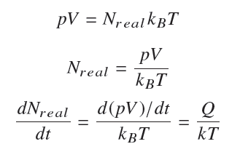
1) The Test-Particle Monte Carlo algorithm as implemented in Molflow+;
Steady-state simulations:
Continuous influx of molecules, all facet parameters are constant in time.
Goal is to determine quantities such as pressure, density, absorption profiles, and more…
The outgassing rate Q=d(pV)/dt is constant.
Q is to be entered in mbar·l/s, but the code converts it internally to SI units (Pa·m³/s)
The number of physical particles entering the system per second, dN_{real}/dt, can be calculated using the ideal gas equation
… where T is the temperature of the facet generating the gas.
The total number of particles is the sum of the particle fluxes from all desorbing facets.

Slide 7
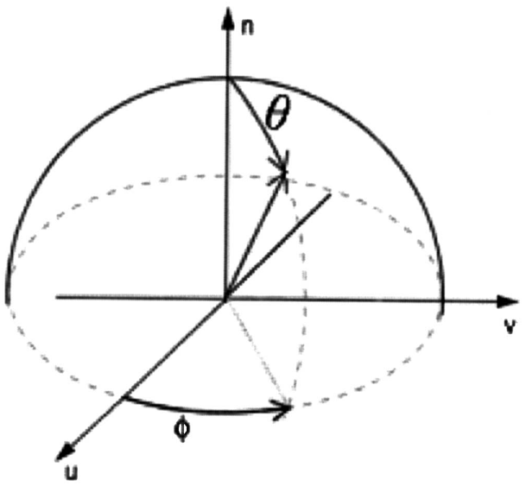
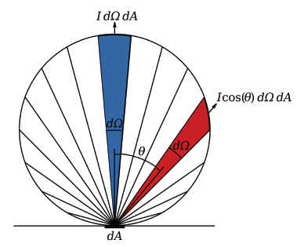
1) The Test-Particle Monte Carlo algorithm as implemented in Molflow+;
Even for a low outgassing rate, say 1.0x10⁻⁶ mbar·l/s, there are ~2.5x10¹³ molecules/s entering into the system → impossible to ray-trace each one of them on a “normal” laptop/workstation!... so…
… use one virtual particle to represent an ensemble of many physical particles (like DSMC)
What the code does, then, is to generate a total of N_{virtual} test particles, and each of them represents number of real particles equal to
Choosing the particle’s direction of emission:
Knudsen’s cosine law is applied
…here θ is the angle between the direction of emission and the normal vector of the emitting
facet
The azimuthal angle φ and polar angle θ can be generated using the following equations:
…. where r is a random number uniformly generated in the real numbers’ interval [0,1]

Slide 8
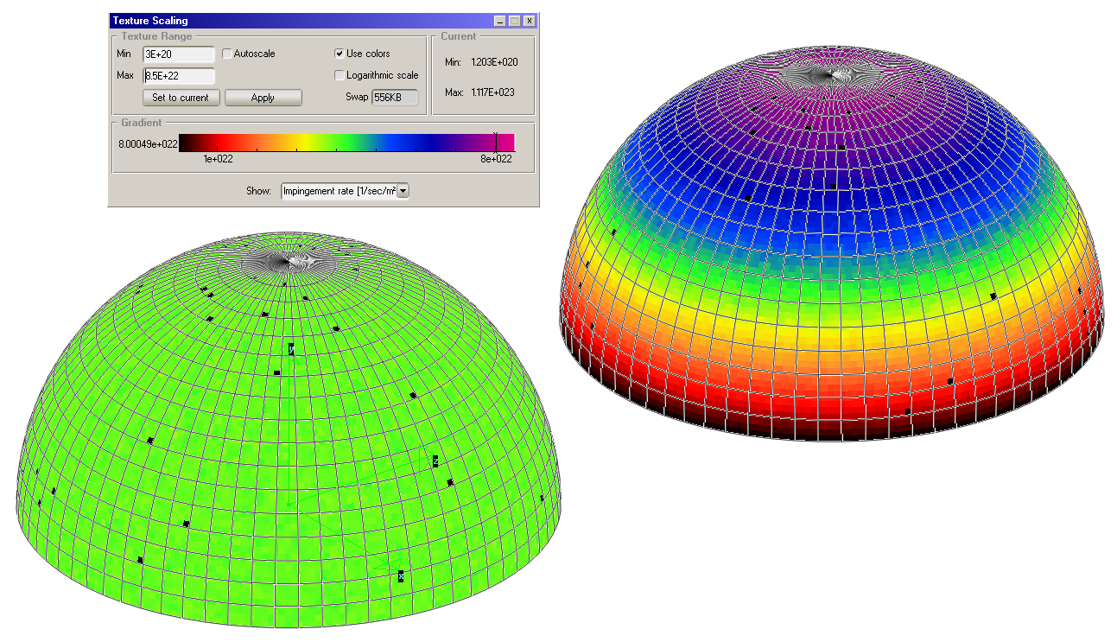
1) The Test-Particle Monte Carlo algorithm as implemented in Molflow+;
For generating r, a fast and precise “Mersenne Twister” assembler code has been embedded into Molflow+: it has a pseudo-random period of (2¹⁹ ⁹³⁷ –1) (24th Mersenne prime number, ~ 4.3x10⁶⁰⁰¹)
Example of generation of two angular distributions with Molflow+: left uniform, right cosine-like . Each half sphere has a small facet generating particles in the center of the equatorial circle(not visible)

Slide 9
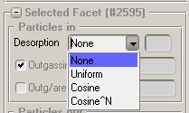
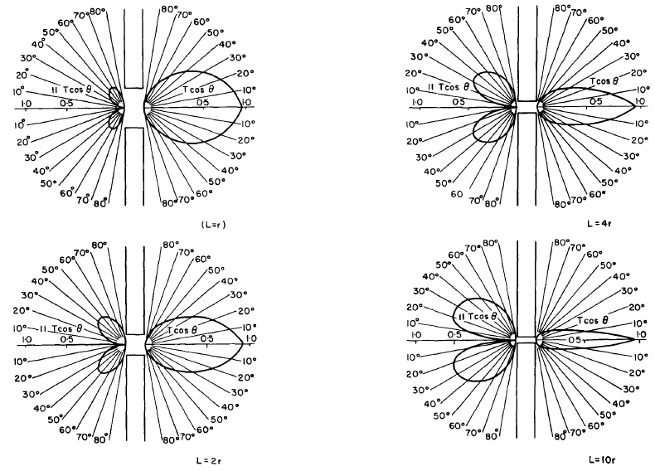
1) The Test-Particle Monte Carlo algorithm as implemented in Molflow+;
Initial desorption direction
Molflow+ allows to set the direction of emission following several distribution functions: cosine-like, uniform, “mirror”, cosine^N
Note: the “Cosine^N” option allows to simulate the “beaming effect” like, for instance, the azimuthal angular distribution at the exit of a long tube (see below). The exponent N needs to be calculated/estimated in advance.
Ref.: “A review of the molecular flow conductance for
systems of tubes and components and the measurement
of pumping speed”, W Steckelmacher,
Vacuum 16 (1966) 561-584

Slide 10
1) The Test-Particle Monte Carlo algorithm as implemented in Molflow+;
Choosing the particle velocity
For an ideal gas in a closed volume the Maxwell-Boltzmann (MB) distribution is the one defining the particle velocity
In an event-driven algorithm the test particles are NOT generated in the volume, but on the surfaces. This is important, since the velocity distribution in this case is different: faster molecules impinge more frequently on the walls (or cross more frequently any transparent facet placed inside the volume) with respect to slower ones.
If f (v)_{gas} is the probability density function (pdf) in the volume, then it is possible to calculate the pdf of the molecules colliding with the wall during a period of time, f(v)_{coll}.
The relationship between the two pdf’s is:
… where C is a normalizing factor (the integral of the pdf must be unitary)

Slide 11
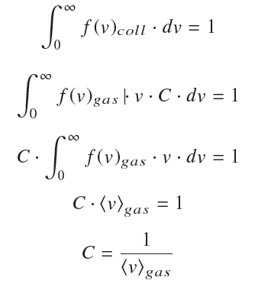
1) The Test-Particle Monte Carlo algorithm as implemented in Molflow+;
We can then write:
… where <v>_{gas} is the average molecular speed
… with R, T, and m the universal gas constant, temperature (K) and molar weight (Kg/mole)

Slide 12
1) The Test-Particle Monte Carlo algorithm as implemented in Molflow+;
With these equations in hand, the numerical inversion method (NIM) is employed to generate the random molecular velocities:
The cumulative distribution function (CDF) and a random number (in [0,1]) are calculated, so as to obtain
At the beginning of each simulation, the CDF function is calculated for 100 equidistant speed values, between 0 and 4 times the most probable velocity of the MB distribution, which is given by , for every facet temperature present in the system.
A higher computational speed could be achieved by calculating the inverse of the CDF and do forward interpolation (interpolate the Y value at a known X value) instead of reverse, but due to the long tail, i.e. non-zero probability for high speeds in the MB distribution, this would introduce artefacts at high velocities.

Slide 13
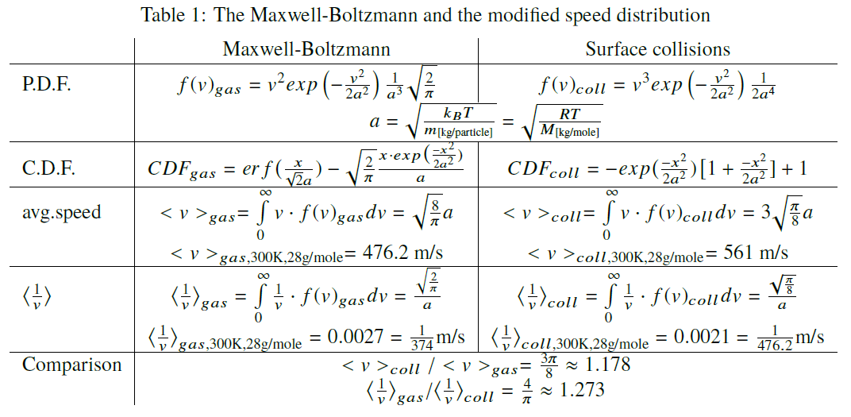
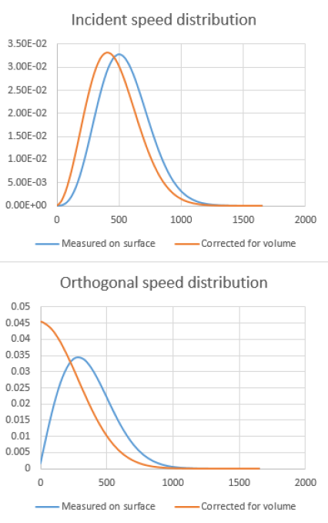
1) The Test-Particle Monte Carlo algorithm as implemented in Molflow+;
The following table summarizes all this. The two plots represent the two pdf’s, on the surface and “corrected” for volume effects (i.e. divided by v):

Slide 14
1) The Test-Particle Monte Carlo algorithm as implemented in Molflow+;
Finding the next collision location
After having generated a direction (θ and φ angles) and the particle’s velocity, Molflow+ applies an optimized ray-tracing algorithm to find the collision point with another facet.
Depending on the sticking coefficient of the target facet, the particle will then undergo the same process (generation of two angles, and one velocity, with eventually a different MB distribution if the target facet temperature is different), until the particle is pumped.
The sticking coefficient of every facet, s, is assigned by the user, and the particle is pumped if, after generating another random number r in [0,1], the relation r < s is true (see below).
For a given source facet, the algorithm calculates the intersections of the ray (infinitely long straight line) with all facets in the model. Therefore the computational speed is (with good approximation) inversely proportional to the number of polygonal facets in the model.
A speed-up can be obtained by defining (if the geometry allows) separate “structures”: in that case the algorithm calculates only the intersections with the facets of the structure where the source facet is (see below).
In this case, every structure must have at least one “link facet” which points at another structure which has to be looked at by the ray-tracing algorithm in order to find the intersection.

Slide 15
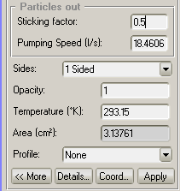
1) The Test-Particle Monte Carlo algorithm as implemented in Molflow+;
Pump or rebound
Generate a random number r in [0,1]: if r < s then the particle is pumped.
The relationship between the sticking coefficient s (no units), and the corresponding pumping speed S (in units of (m³/s)) of a facet of unit area (1 m²) is obtained via the relationship
... where the average gas velocity is given, as already seen, by . .
If the area of the facet is not 1 m², then a multiplicative factor A must be introduced, equal to the area in m², obviously.
After selecting a facet, Molflow+ provides an automatic conversion
of the pumping speed to the corresponding sticking coefficient,
and viceversa:
Note that the customary units in Molflow+ are not SI, (l/s) instead of
m³/s, and therefore the linear dimensions should be in cm, rather
than m.

Slide 16
1) The Test-Particle Monte Carlo algorithm as implemented in Molflow+;
Registering hits
By definition, pressure on a surface is the momentum change rate of particles colliding with it. Every facet (or texture or profile slice, see later) has three hit counters in memory that are incremented by the following quantities at every hit with the target facet:
We increment N_{hit} , the "number of Monte Carlo hits“ counter by 1. Knowing the number of MC hits on a facet will allow us to calculate the impingement rate, moreover it provides important information on the statistical accuracy of our results;
To , the "total orthogonal momentum change“ counter, we add the orthogonal momentum change, , of the incoming particle (θ is the test particle’s incident angle, v is its speed, and m is its mass);
We also use a third counter, to store the sum of the reciprocals of the orthogonal speed components, . . We need to store this quantity for the calculation of the particle density near the facet, as explained later.

Slide 17
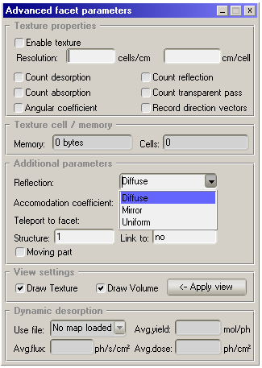
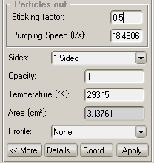
1) The Test-Particle Monte Carlo algorithm as implemented in Molflow+;
Rebound
Once the hit registers are incremented, the algorithm proceeds to the next iteration, by assigning a new velocity and a new direction. The direction can be cosine-like (diffuse), uniform, or “mirror”.
The new speed depends on the thermal accomodation coefficient, A_{acc} . By default, total thermalization (A_{acc} = 1) is assumed, in which case - regardless of the incident velocity - a new velocity v_{new} is generated according to the frequency-modified speed distribution, which takes into account the facet’s temperature. If the user changes this coefficient, then the new velocity is calculated as:
… where v_{old} is the incident velocity and the thermal accommodation coefficient, A_{acc} is
between 0 and 1.

Slide 18
1) The Test-Particle Monte Carlo algorithm as implemented in Molflow+;
Rebound (continued)
Once the new speed and direction are chosen, then the orthogonal momentum change and speed reciprocal counters of the facet are incremented again to take into account the outgoing particle’s impulse and velocity reciprocal.
Calculating physical quantities
Using the counters above, the following physical quantities can be calculated:
Impingement rate: the impingement rate on a wall is the number of collisions, N_{real} per second per unit area. To calculate it, we need the following quantities:
The number of incoming physical molecules per second that each test particle represents,
K_{real/virtual}
The number of test particle hits on the given facet, N_{hit}
The area of the facet, A
With all the above, the impingement rate, z, can be written as follows:
Molflow+ applies a few more coefficients to correct for 2-sided and semi-transparent facets, but for simplicity they are not introduced here.

Slide 19
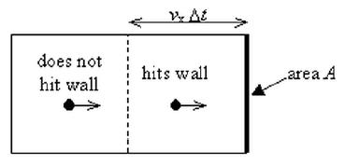
1) The Test-Particle Monte Carlo algorithm as implemented in Molflow+;
Calculating physical quantities (continued)
Pressure: When particles desorb from, are absorbed by, or bounce on a facet, their change of momentum exerts a force on the wall, which - divided by the area - is the pressure. Since we have previously stored the sum of momentum changes in a dedicated counter, to obtain the pressure all we have to do is to scale it up by the K _{real/virtual} ratio and then normalize by the facet area:
(Note that at this time Molflow+ does not take into consideration the sojourn time)
Density: At first it might seem difficult to calculate the density directly in Molflow+: as already said, in an event-driven simulator, the main idea is to simulate events only on walls and ignore everything in the volume between, whereas for a direct density measurement we would need to count the number of test particles in a test volume. It is, however, achievable through a simple derivation that connects the density in a volume with the number of particles crossing a surface nearby:
Only particles with high enough orthogonal velocity
will hit the surface in the next Δt period.

Slide 20
1) The Test-Particle Monte Carlo algorithm as implemented in Molflow+;
Calculating physical quantities (continued)
As shown on the previous figure, a molecule traveling with velocity V┴ will hit a surface within time Δt if it is closer than V┴ Δt to the wall. Therefore, the number of collisions for molecules traveling with velocity V┴ during the next Δt period is:
where N/V is the density of molecules and A is the surface area. Since there is a distribution of
molecular velocities, we integrate this expression over the velocity distribution f(V┴):
And since the impingement rate is the number of collisions per unit time and area, we can write:

Slide 21
1) The Test-Particle Monte Carlo algorithm as implemented in Molflow+;
Calculating physical quantities (continued)
We already know how to calculate the impingement rate, as explained above.
Obtaining < V┴ >_{gas} is more tricky, though. Unless we use test volumes or other computational tools, we won’t be able to calculate it directly.
What we can measure, however, is the speed distribution on the facet.
Using the definition we can write:
Then using the identity v ·1/v = 1, we continue:
Then using as previously found:

Slide 22
1) The Test-Particle Monte Carlo algorithm as implemented in Molflow+;
Calculating physical quantities (continued)
Then, from the same subsection, using we can write:
Therefore, the density on a facet, using the counter, becomes
Average orthogonal velocity: As described above and also shown in Table 1, the average speed in the gas can be calculated as:

Slide 23
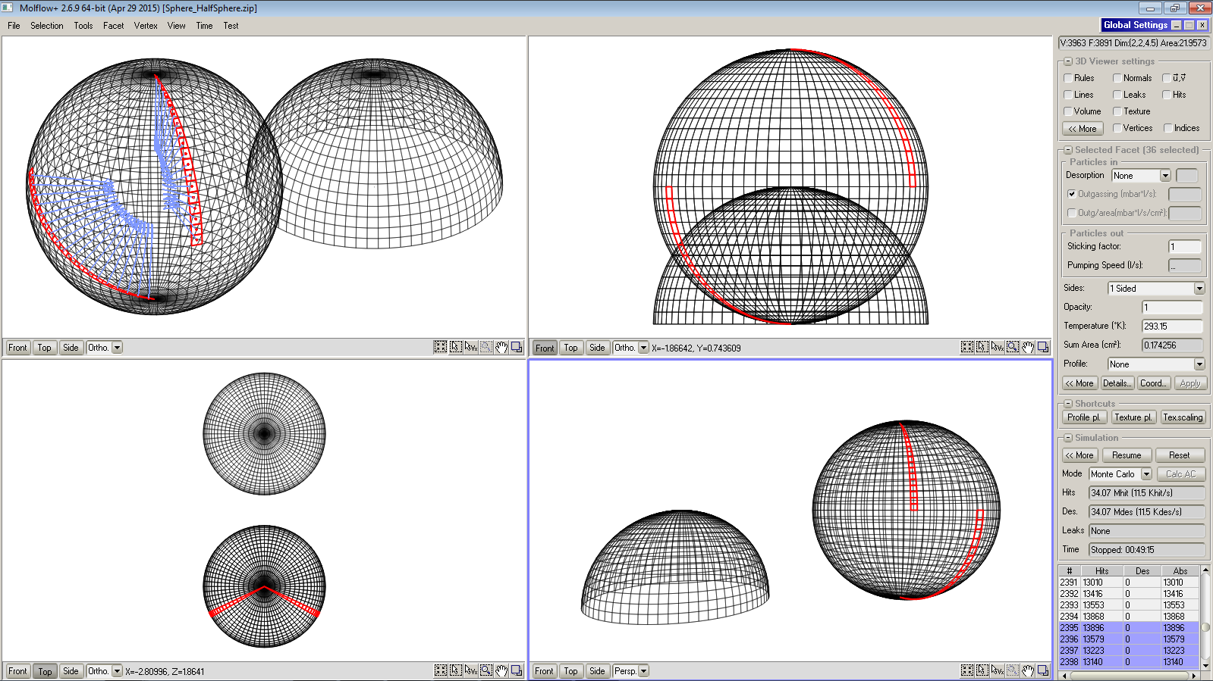
2) Program menus and commands;
Overview:
Menus with sub-menus
Panes with sub-menus
View mode and projections
Window mode and pointer selection

Slide 24
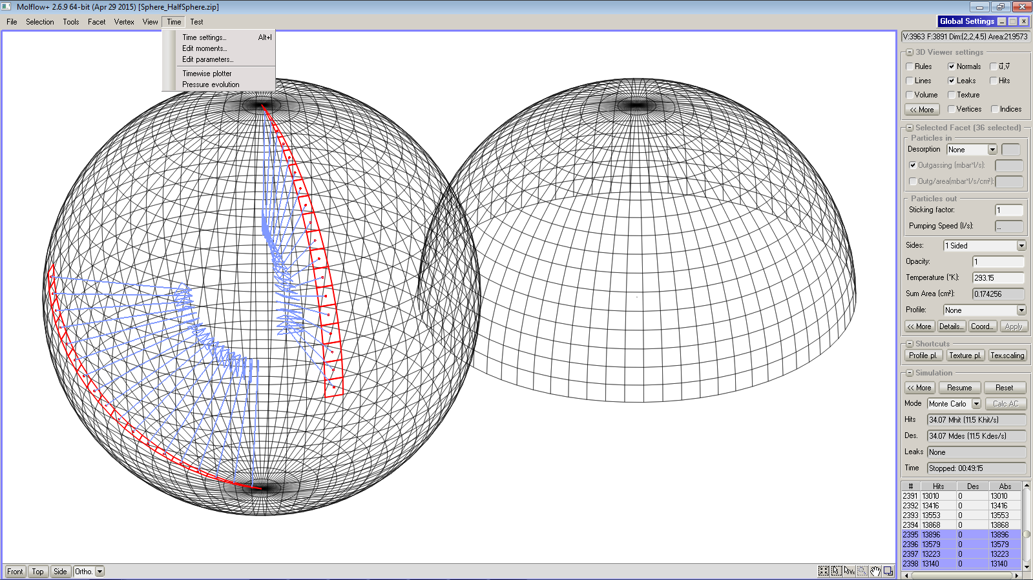
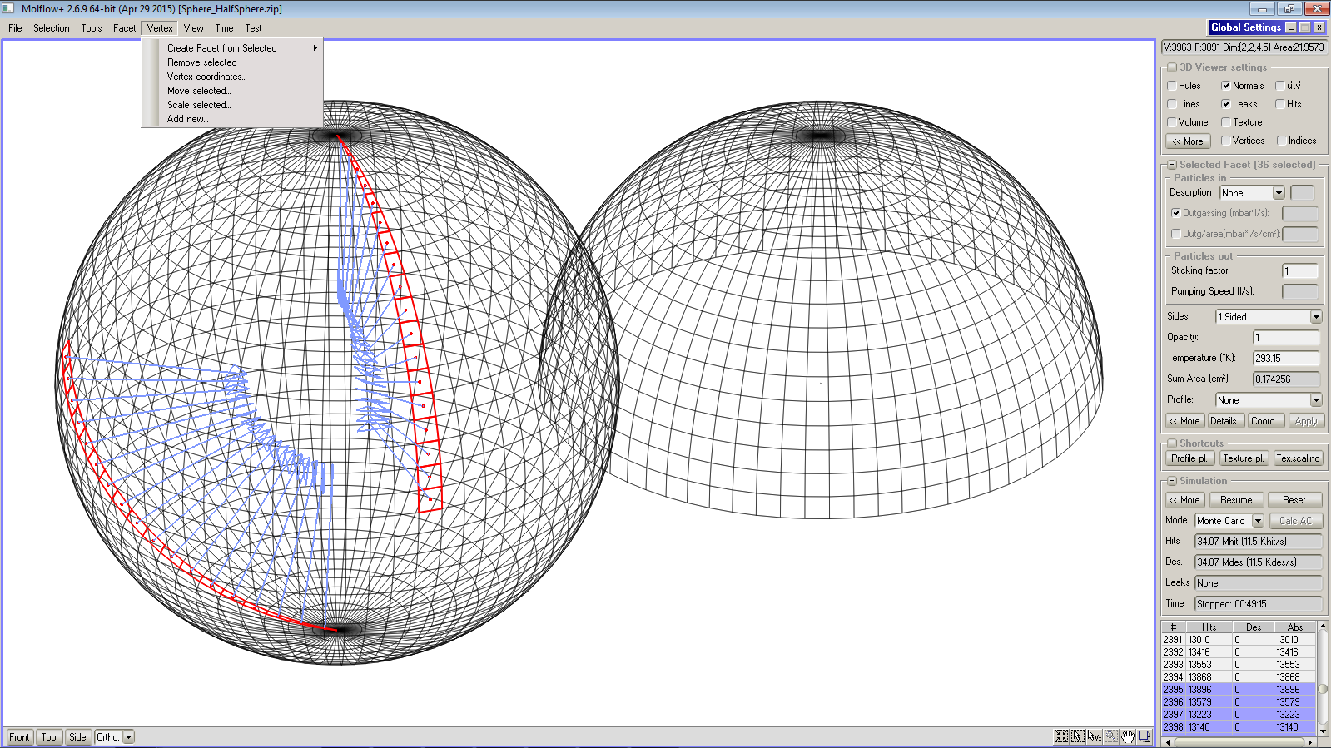
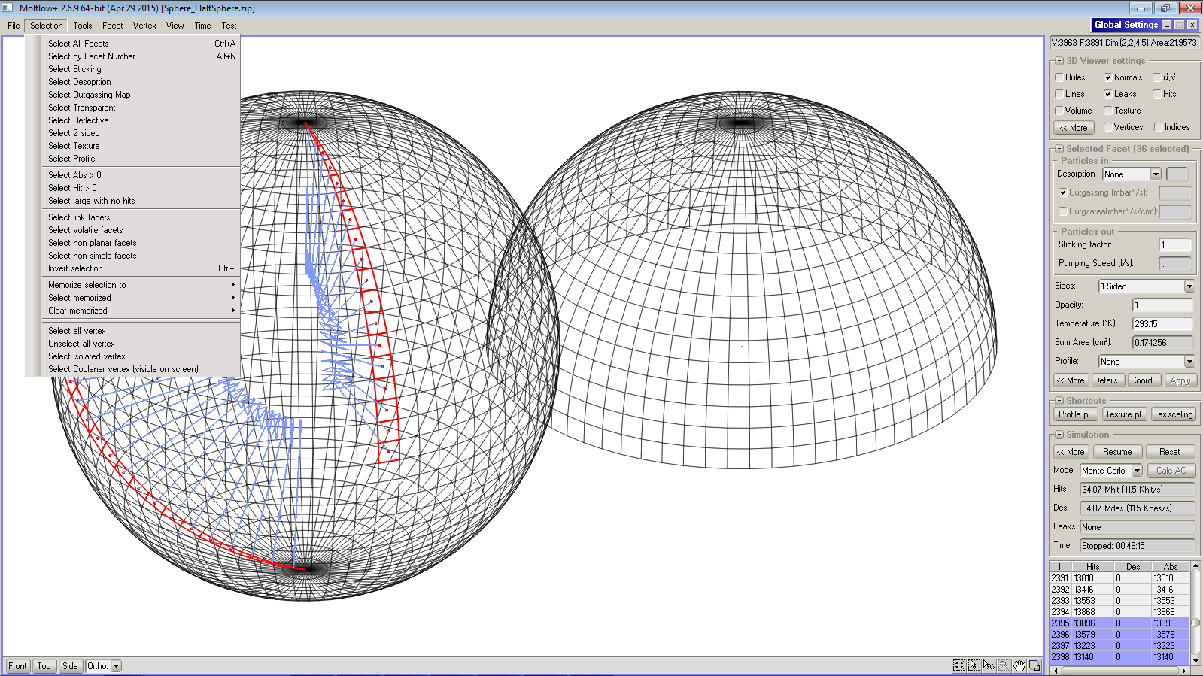
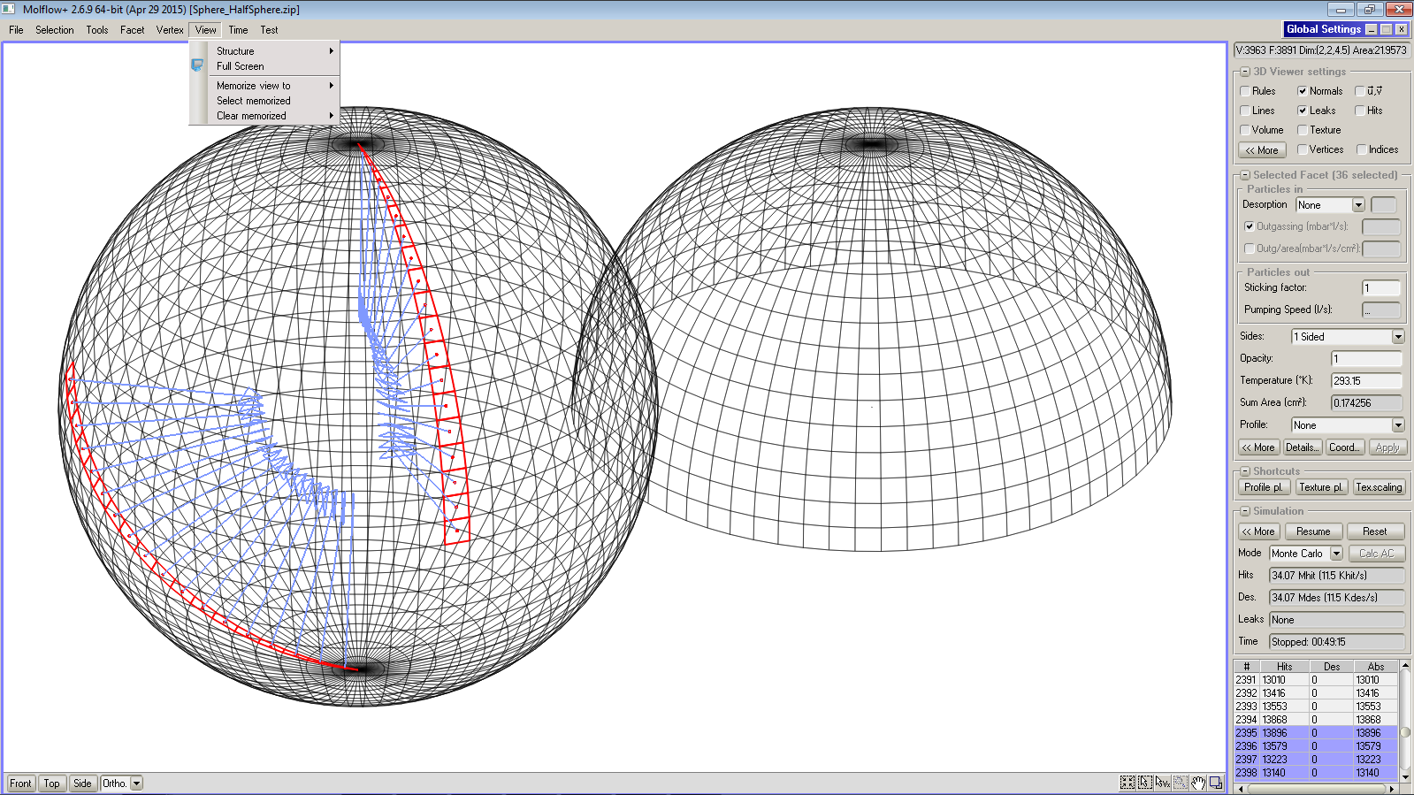
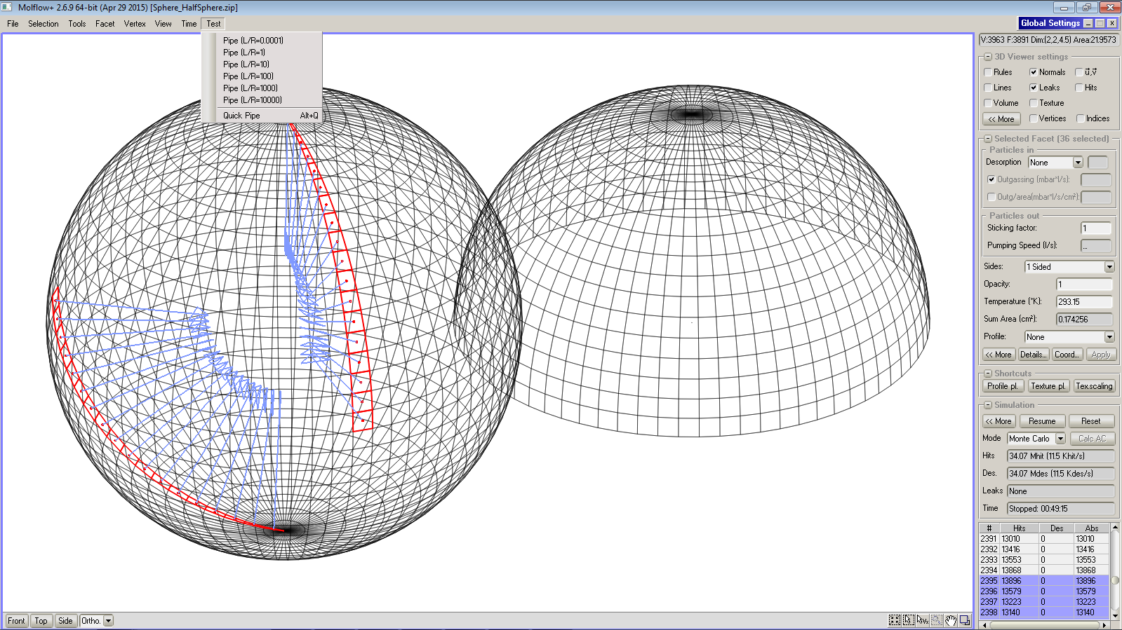
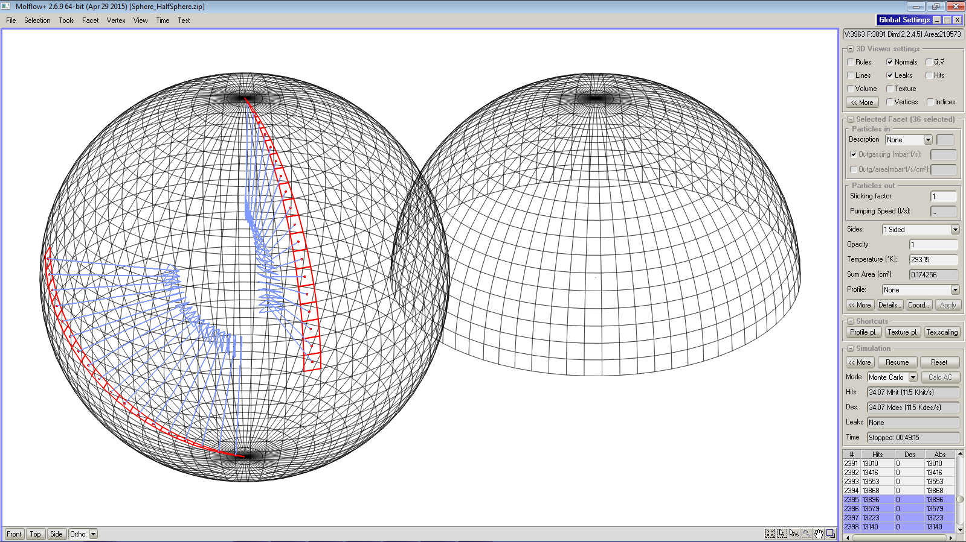
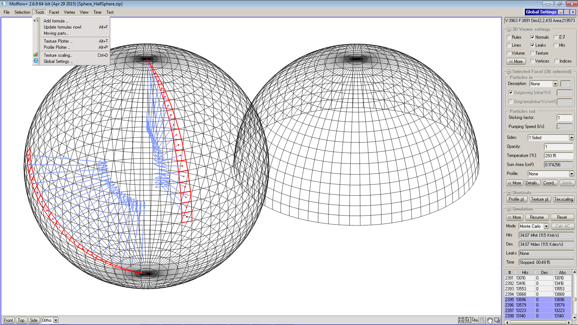
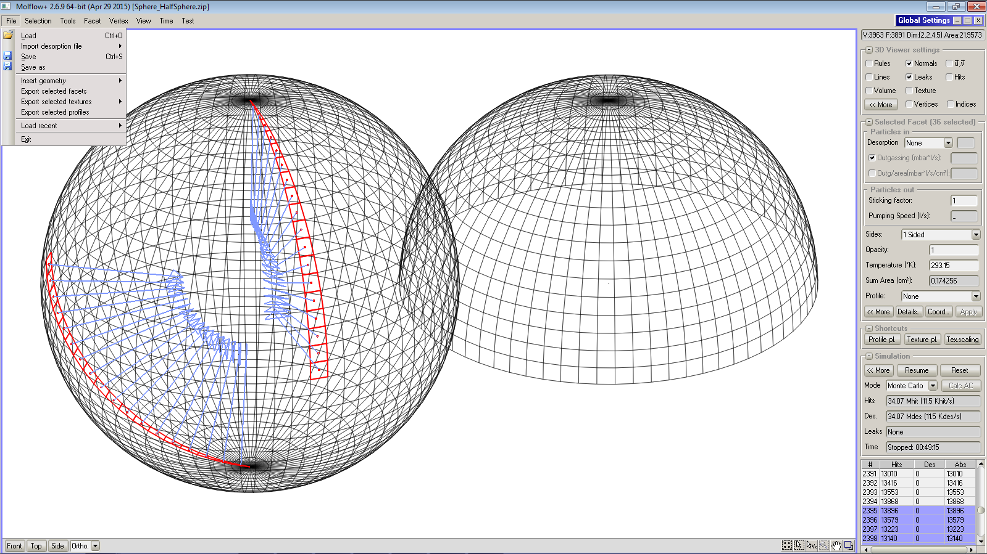
2) Program menus and commands;
Menus and sub-menus:

Slide 25
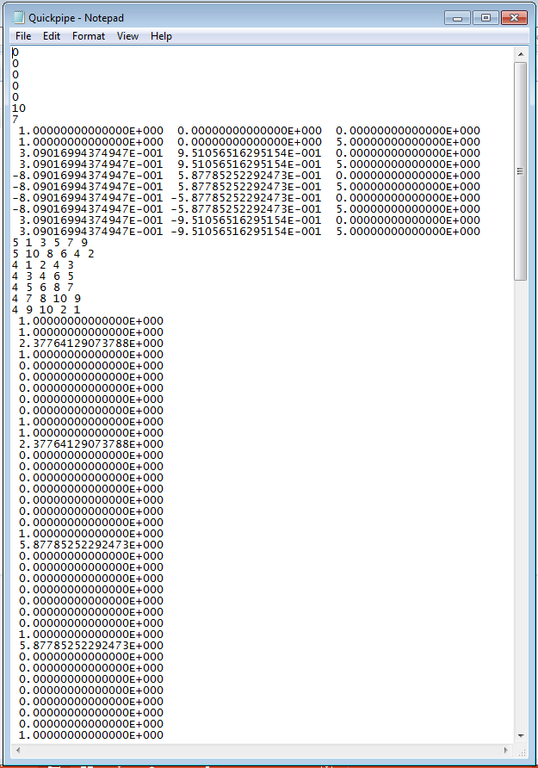
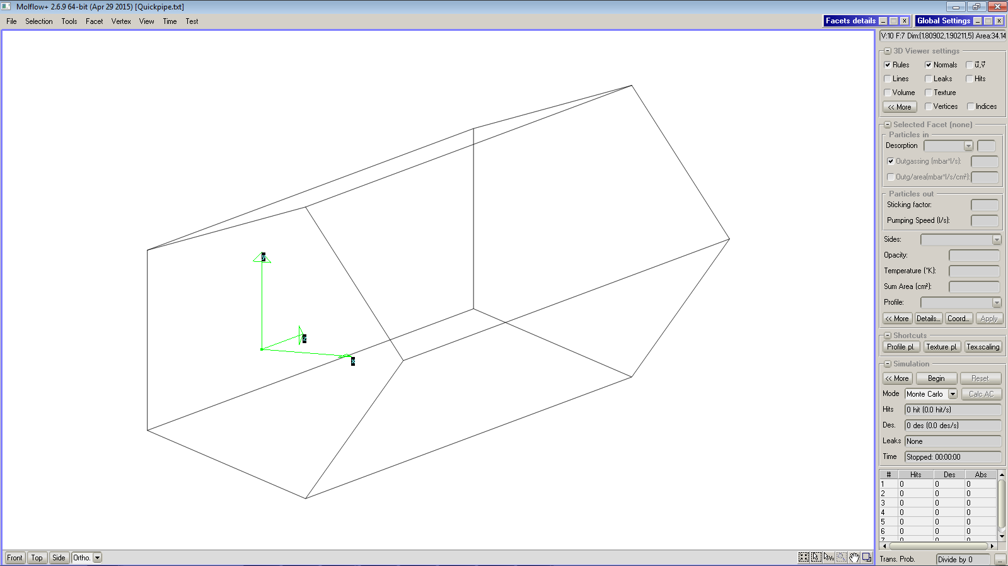
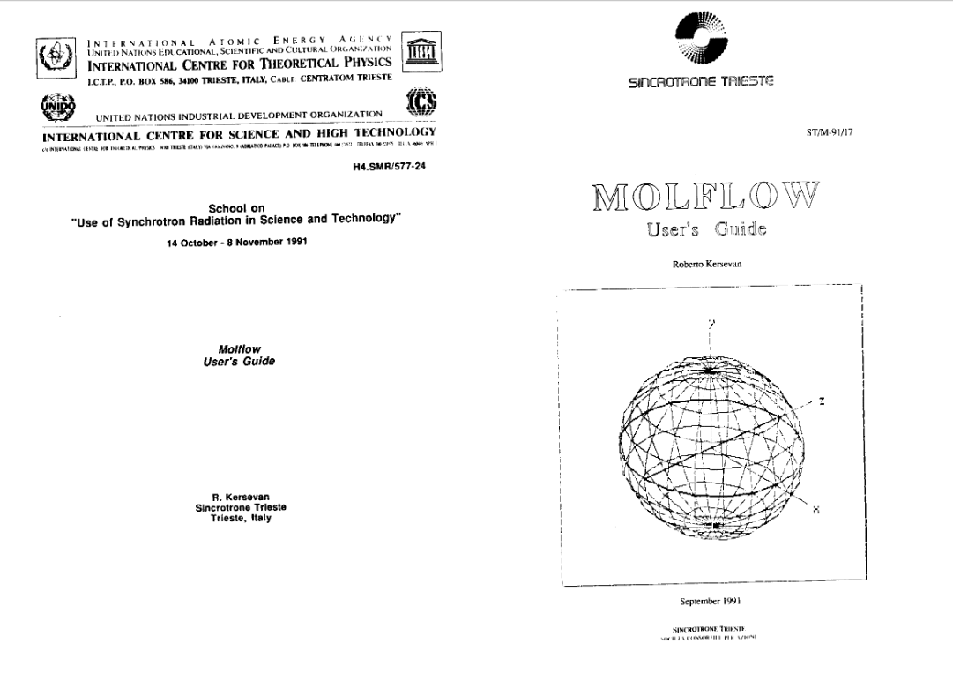
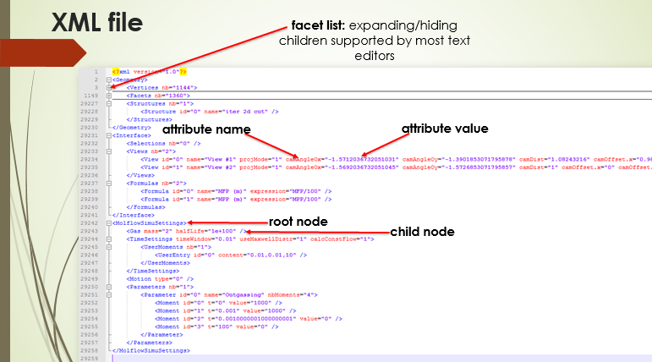
3) File formats: txt, stl, geo, html: why and what;
Evolution of the file types:
txt: (compatibility with old DOS Molflow,
(http://indico.ictp.it/event/a0246/contribution/23)
stl:
geo: (shared with SYNRAD+)
geo7z: “ “ “
zip (xml):

Slide 26
4) Transmission probability and conductance;
The concept of transmission probability is of paramount importance in the field of vacuum technology:
For a vacuum system (model) with one source of gas on facet i and one pump (facet j, with sticking =1), the transmission probability P_{tr} is defined as:
P_{tr} = N_{pumped}(j)/ N_{des}(i)
where N_{des}(i) is the number of molecules desorbed by facet i (which also has sticking=1), and
N_{des}(j) is the number of molecules pumped by facet j.
In an analogous way, the backscattering probability is defined as:
P_{back} = N_{pumped}(i)/ N_{des}(i)
The standard deviation σ associated to P_{tr} is given by the formula:
σ=$√(Ptr∗(1−Ptr)/Ndes)$
We define then the transmission conductance between facets i and j; it is given by:
C_{tr} (l/s) = P_{tr} * A (cm²) * ¼ <v>_{gas}
where A is the area in cm² of the desorbing facet i, and the kinetic factor ¼ <v>_{gas} is equal to
11.77 l/s/cm² for N₂ at 20 ºC (we have seen earlier that )

Slide 27
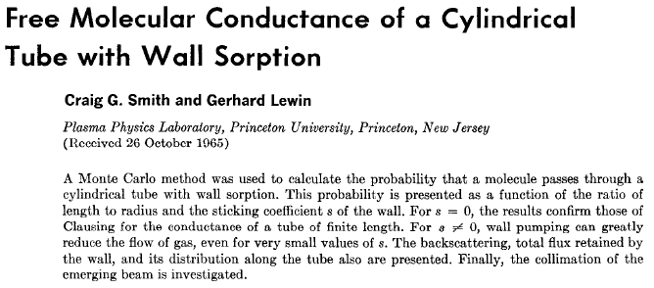
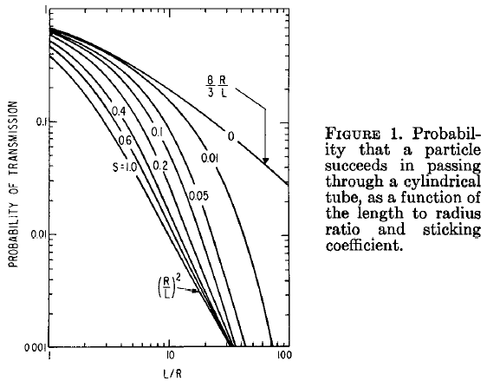
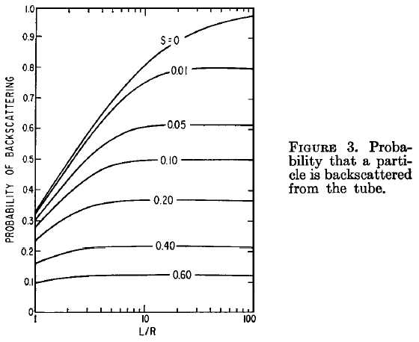
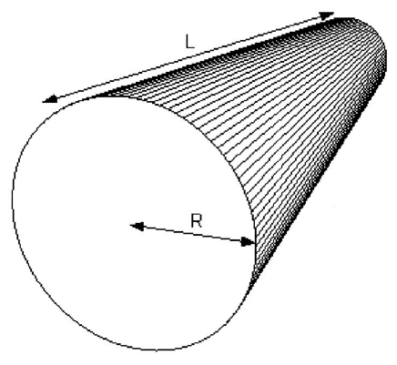
4) Transmission probability and conductance;
The transmission and backscattering probabilities have been one of the first applications of the test-particle montecarlo method, as for instance here:
“Free Molecular Conductance of a Cylindrical Tube with Wall Sorption”, C.G. Smith, G. Lewin, J. Vac. Sci. Technol. 3 (3) 1966 92-95
“Introduction to Molflow+: New…”,
R. Kersevan, J.-L. Pons, JVST A 27 (4) (2009) 1017-1023

Slide 28
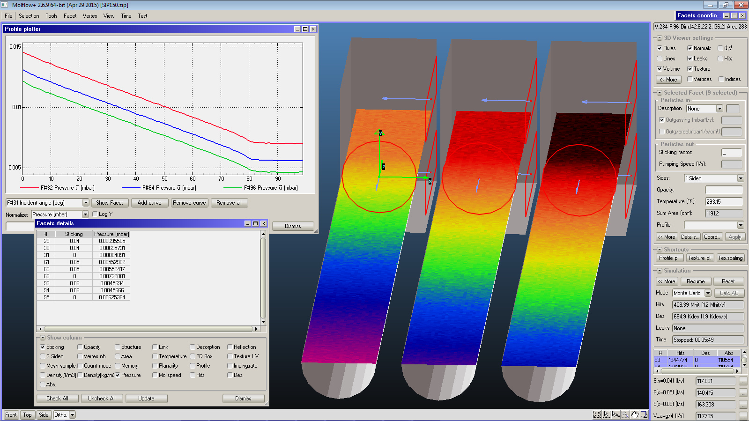
1) Simulating pumps;
It has already been mentioned that in Molflow+, a pumping surface is simulated by assigning the proper sticking coefficient to it.
In order to speed-up the calculation of, for instance, the pressure profile along a tube pumped at one end by an ion-pump, one could model in detail the pump and find out what sticking coefficient at the pumping pockets gives the nominal pumping speed at the flange…
… and then assign an equivalent sticking coefficient to the facet representing the opening of the flange and discard the detailed geometry of the ion-pump: (see practical session 1, group 2)
Sticking:
s=0.04
s=0.05
s=0.06

Slide 29
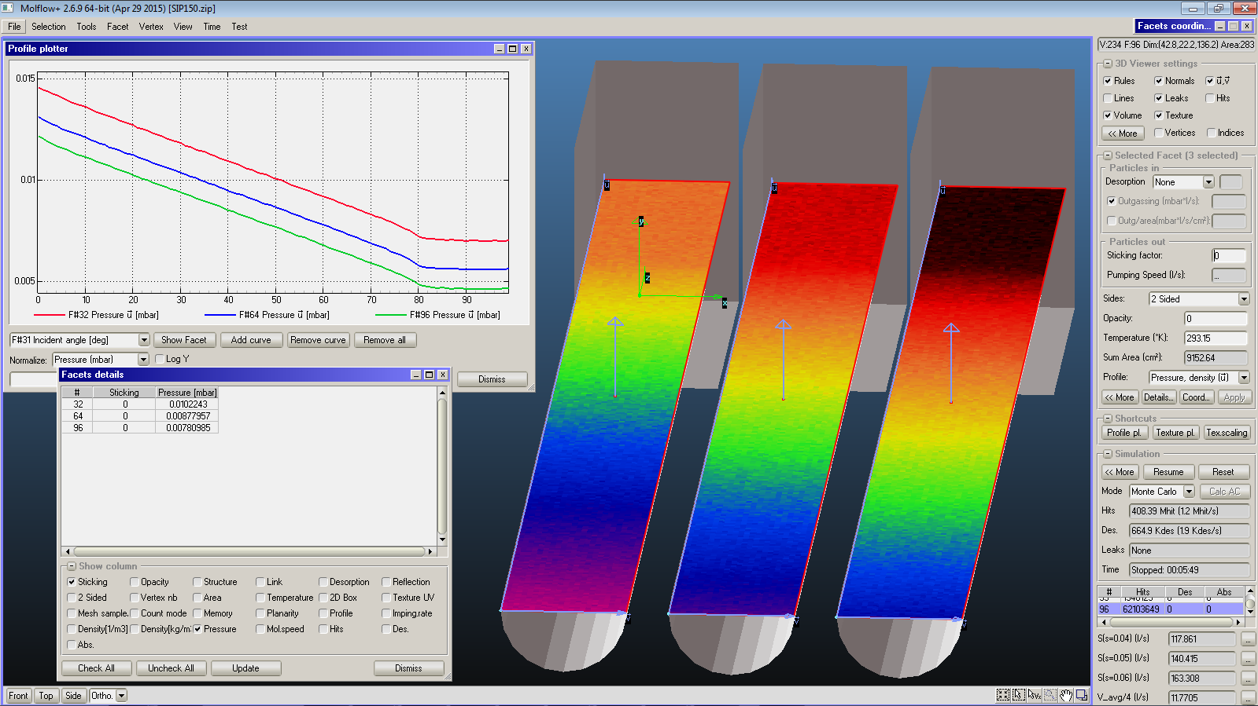
6) Pressure, angular and density profiles: how to get the most out of them;
Molflow allows setting up “pressure test facets” and “textured facets”. The former are facets which can record the number of hits along a rectangular facet, by slicing the rectangle into 100 slices of equal width.
In the example of the ion-pumps, the three profiles in the inset are calculated by slicing the 3 coloured facets (which are virtual facets, not real ones)

Slide 30
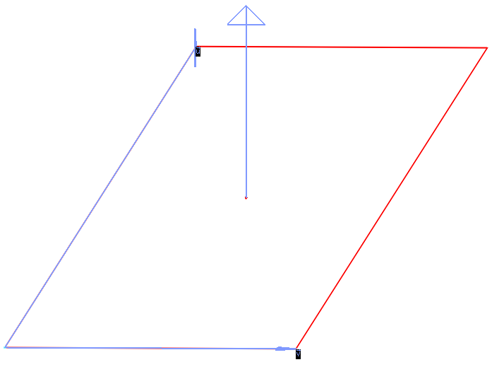
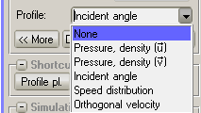
6) Pressure, angular and density profiles: how to get the most out of them;
A test facet can be “sliced” in one of two possible directions: one parallel to the “u” vector (u), the other to the “v” vector (v), which is perpendicular to u.
u and v are defined as the local Cartesian frame of reference of the rectangular facet:
A test facet can also record the angle of incidence of the molecules impinging on it (or passing through it if it is transparent). In this case the “Incident angle” option should be selected in the “Profile” pull-down menu:
u
} ^{1… 100}
v

Slide 31
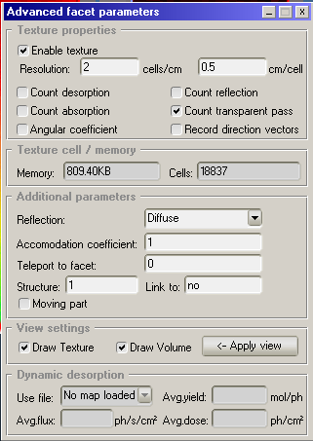
7) Textures: how to implement them and how to use them; memory management;
In the same example, the three test pressure facets have also been textured. Texturing means creating a mesh of (usually) square elements of size which can be set by the user, by clicking on “More” in the “Selected Facet” pane.
A facet can be textured with respect to different parameters: desorption, reflection, absorption, transparent pass, velocity vectors (angular coefficients is not used anymore)

Slide 32
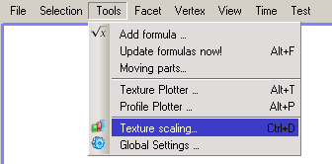
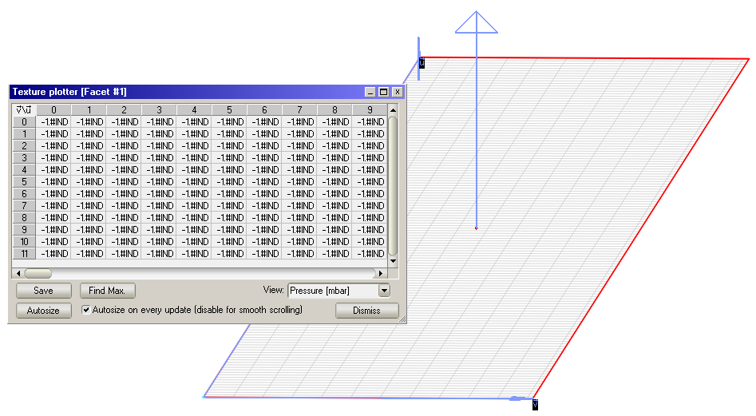
7) Textures: how to implement them and how to use them; memory management;
For the textured facets, a square mesh is created, which looks like this:
The “texture plotter” in the “Tools” menu allows the user to read the individual values of each texture element

Slide 33
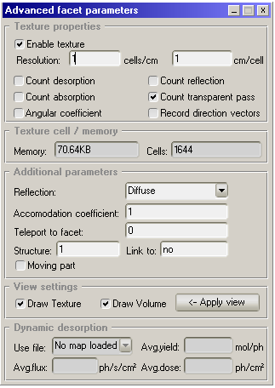
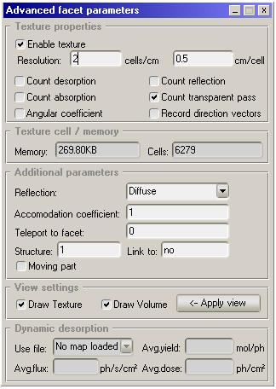
7) Textures: how to implement them and how to use them; memory management;
Pay attention to the mesh element size that you choose: the size of the corresponding texture plotter matrix increases quadratically with the reciprocal of the mesh element linear size
Since ~ 2021 non-square texture elements are implemented too: useful when simulating systems with one dimension much bigger than the other two, e.g. accelerator or gravitational wave detectors pipes
Make sure the allocated memory is not too much for your computer!

Slide 34
8) Optimizations: multi-structured models, teleportation; taking advantage of symmetry axis and planes, speed optimization;
Multi-structured models
Multi-structure models are used in order to facilitate the analysis of vacuum systems which are made up of several parts (e.g. one long tube connecting two domes, can be split up in 3 elements (“structures”), the two domes and the tube within them).
It is possible to tell Molflow+ not to calculate the intersections of each ray with every facet in the model, but only with the facets belonging to the structure where the ray was originated. If the ray happens to hit/cross the interface between one structure and another one adjacent to it (“link” facet), then and only then the algorithm looks for intersections of the traced ray inside of the other structure.
When this procedure is implemented in a smart way, it is possible to save some time, and accelerate the computation.
It is also useful when running/comparing different simulations where only a part of the model is subject to changes.
A simple example follows:

Slide 35
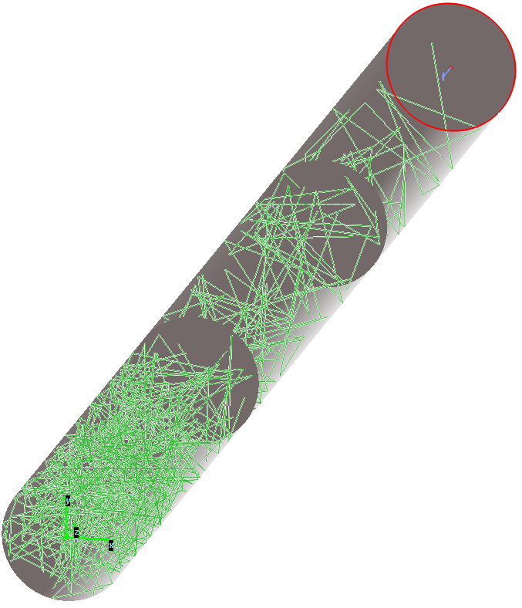
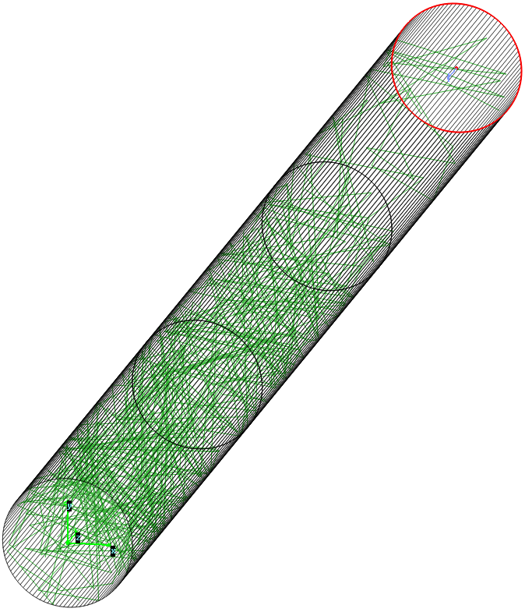
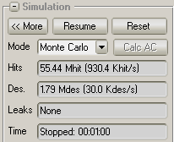
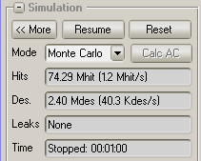
8) Optimizations: multi-structured models, teleportation; taking advantage of symmetry axis and planes, speed optimization;
Multi-structured models
Three circular tubes connected in series: case 1 (left) is with one structure only.
case 2 (right) with 3 independent structures linked at the common round openings of each tube (1⬄2 and 2⬄3).
Notice the increased computational speed of case 2, ~ 30% higher.

Slide 36
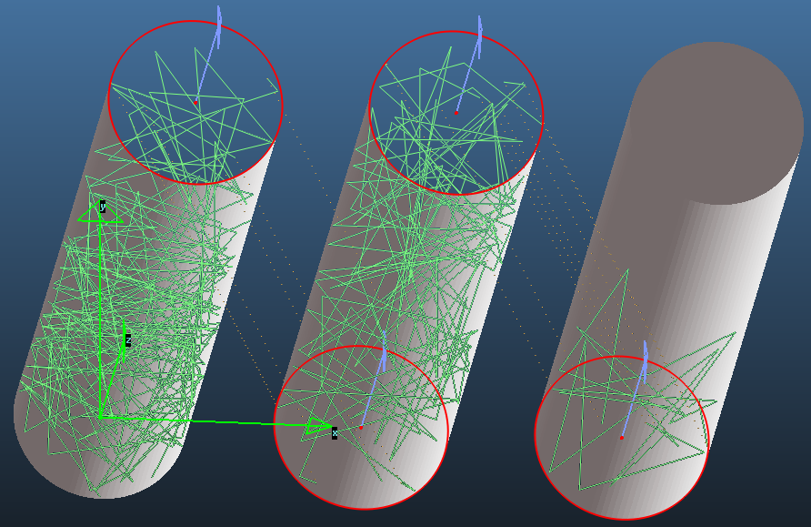
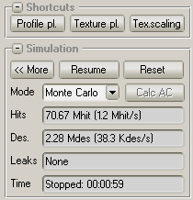
8) Optimizations: multi-structured models, teleportation; taking advantage of symmetry axis and planes, speed optimization;
Teleportation
In Molflow+ the term “teleportation” is used when some facets link other facets which are not physically adjacent and connected to them. In the previous example with 3 structures in series, we can put them side-by-side and connect the end of each one with the entrance of the following one: 1 ⬄ 2, 2 ⬄ 3: same speed as for the 3 structures simply linked (case 2 before)

Slide 37
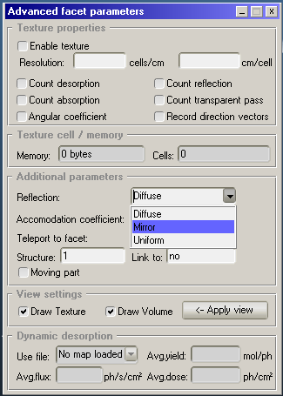
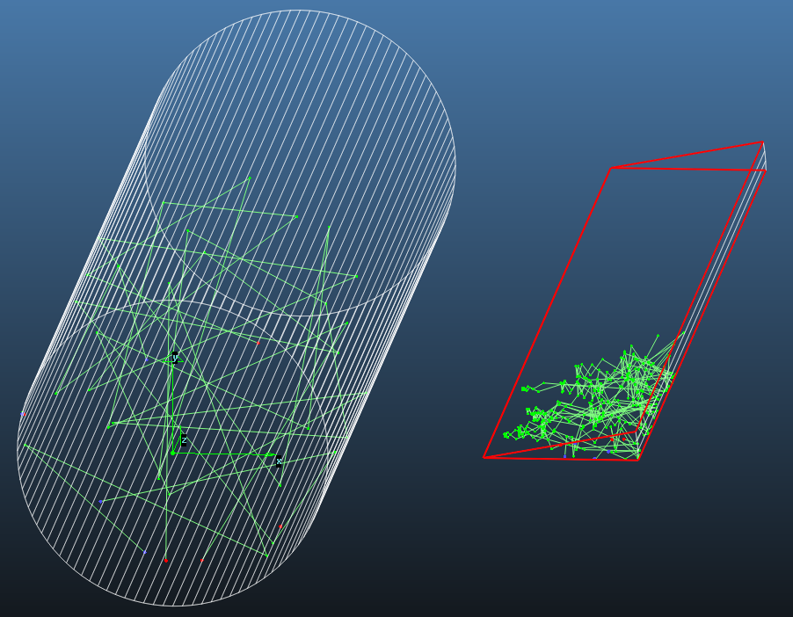
8) Optimizations: multi-structured models, teleportation; taking advantage of symmetry axis and planes, speed optimization;
Symmetry axis and planes
Whenever a symmetry axis or plane are present, it is possible to simplify and greatly reduce the number of facets (but not necessarily the computational speed) by taking advantage of these symmetries.
Example: The “slice” (on the right) of the round tube gets the same transmission probability as for the whole tube.
The reflection on the two virtual
facets highlighted in red is set to
“mirror” (or they could be
teleported one to each other)

Slide 38
9) Time-dependent simulations: what you can do and what you can't (yet); Time-dependent parameters;
Why time dependent and how
Starting from version 2.4, Molflow+ has been extended to the time domain as well. The idea is that once we keep track of the molecular speeds, it is possible to determine when each hit happens. A new menu has been introduced.
Then, on every facet, instead of calculating the statistics with every registered hit, we take into account only those that happen at a certain time interval (“moment”) – and doing so we can obtain the value of some physical variables at that moment.
The algorithm is very similar to that of the steady-state simulations explained before, but some corrections and fine-tuning is applied.
Parameters
The first thing to elaborate is the concept of time-dependent parameters.
Starting from version 2.6, each facet’s sticking factor, opacity and outgassing rate values can be either a constant value, or a time-dependent parameter.
In the latter case, the user enters the name of the parameter in the textbox corresponding to the physical property of the facet (see next slide).
Then he/she proceeds to define the parameter by entering a list of time moments and the corresponding parameter values.

Slide 39
9) Time-dependent simulations: what you can do and what you can't (yet); Time-dependent parameters;
Why time dependent and how (continued)
Molflow+ performs a linear (or logarithmic) interpolation between the defined moments. For the time region outside of the defined moments, it will consider the value corresponding to the first or the last moment.
(Note that the parameter name is case-sensitive!)
← NEW VERSION

Slide 40
9) Time-dependent simulations: what you can do and what you can't (yet); Time-dependent parameters;
Why time dependent and how (continued)
The time window can be set by the user. In practice, it
has to be small enough to reveal the fast pressure changes
in the system, but large enough to contain a number of hits
that is sufficient to guarantee statistical accuracy.
The good choice is one that matches the “natural” rate of change
of the pressure in the system. Often it needs to be found by
trial and error.
In this example the “time window width of 0.1 s would generate an error message, since it is bigger than the time separation between moments (0.01 s) and therefore there would be an overlapping/double counting of some hits →

Slide 41
9) Time-dependent simulations: what you can do and what you can't (yet); Time-dependent parameters;
Why time dependent and how (continued)
This is demonstrated in this figure, where we inject gas at a rate of Q = 0.01 mbar·l/s
between t_{start} = 0.001 s and t_{stop} = 0.005 s into a volume V = 11.88 cm , and then pumping at
S = 2.62 l/s.
The pressure profile should follow the analytic equation
during injection and
during pump-down, with a characteristic time τ = V / S = 4.5.10⁻³ s.
We can see that choosing a large time window will smooth out and thus hide the beginning of the injection and the pumpdown (top fig.)
On the other hand, too small of a Δt would generate more statistical noise (bottom fig.)
The optimal time window, Δt_{window} = 5.0.10⁻⁵ s is approximately τ / 100 (middle fig.)

Slide 42
9) Time-dependent simulations: what you can do and what you can't (yet); Time-dependent parameters;
Particle generation
The main goal of implementing the time-dependent mode is to simulate processes with time-dependent outgassing: pulsed gas injections, gas puffing and pump-downs.
When an outgassing is time-dependent, we must...
Generate particles so that the distribution of their time of injection (initial flight time) follows the user-defined desorption parameters.
Know how many real molecules one test particle represents.
Both tasks can be solved by integrating the user-defined desorption on the range t = t₁… t_{last}, where t_{last} is the last user-defined moment where the pressure needs to be calculated (after which we are not interested in the behaviour of the system).

Slide 43
9) Time-dependent simulations: what you can do and what you can't (yet); Time-dependent parameters;
Calculating physical quantities
The difference with respect to the analogous steady-state case is that Molflow+ calculates the various “hit counters” during a given time-window.
The impingement rate z for the i-th moment is therefore given by
The pressure is given by
For the density,

Slide 44
9) Time-dependent simulations: what you can do and what you can't (yet); Time-dependent parameters;
Calculating physical quantities (continued)
Finally, the average orthogonal velocity for the i-th moment is given by
Time-dependent visualization tools
Two new plotting tools are dedicated in Molflow+ to time-dependent simulations:
The Timewise Plotter is a modified version of the Profile Plotter which - instead of showing pressure profiles on several facets at the same moment - shows the pressure profiles at different moments (user-adjustable) on one chosen facet.
The Pressure Evolution window shows how the pressure on a profile changes over time: the X scale contains all the user-defined moments, and the Y value is the pressure, density or velocity either averaged over the whole facet, or only on a selected slice of the profile (see practical session)

Slide 45
10) Non-isothermal models;
There are many occasions when the vacuum scientist is faced with systems which are non-isothermal.
One example in the accelerator field is a room-temperature vacuum chamber connected to a cryogenic equipment (e.g. superconducting magnet or RF cavity).
In this case the concept of pressure can be misleading: it is better to use the density, because it is this physical quantity which causes the “interaction” (of whatever type it may be) with the particle beam (or other effect which should be minimized or maximized by a given process); see lecture by O.B.Malyshev, this school, for further details, and paragraph 11 here below.
A thermonuclear fusion reactor like ITER is another good example: during a shot, its plasma vessel is kept hot (around 150~200 ºC) while its huge cryogenic pumps run at less than 10 ºK, and there is a > 400 ºK temperature gradient along the path of the gas species which need to be pumped.
The latest versions of the Molflow+ code have integrated the correct treatment of different temperatures in the system (see below).

Slide 46
11) Radiometric and thermal transpiration effects;
We provide here a few examples of the application of the code to the analysis of the thermal transpiration between two large volumes kept at different temperatures, T₁ and T₂, and connected by a round tube which has a temperature gradient along its axis (from T₁ to T₂).
The pressures in the two volumes are kept at P₁=0.003 mbar, and P₂=0.2·P₁
The details of the simulations will be shown during the practical session.
80ºK
300→80K
300ºK

Slide 47
11) Radiometric and thermal transpiration effects;
A second example shows how radiometric effects can be simulated correctly with Molflow+. In this case a round disc, having its two round sides kept at different temperatures, is simulated; T_{cold}=93 ºK; T_{hot}=493 ºK; T_{volume}=293 ºK (α_{Ε}=0.75)
The details of the simulations will be shown during the practical session.

Slide 48
12) Moving surfaces: Parallel moving and rotations;
Although not optimized for this kind of calculations, another field of application of Molflow+ is the analysis of systems where one or more surfaces move (rotation or translation with constant velocity vectors).
A typical application is the calculation and optimization of the compression ratio of one stage of a turbo-molecular pump, or the creation of a radial molecular density gradient inside a rotating drum.
Another case, often found in literature, is when one or more surfaces move along a straight line (parallel). This can describe some micromechanical devices, or be a first approximation for some type of pumps (molecular drag).
A third example is given: calculation of the compression ratio for different geometries and degrees of abstraction of one stator-rotor turbo-molecular pump stage.

Slide 49
12) Moving surfaces: Parallel moving and rotations;
A typical application is the calculation and optimization of the compression ratio of one stage of a turbo-molecular pump, or the creation of a radial molecular density gradient inside a rotating drum.

Slide 50
12) Moving surfaces: Parallel moving and rotations;
Another case, often found in literature, is when one or more surfaces move along a straight line (parallel). This can describe some micromechanical devices, or be a first approximation for some type of pumps (molecular drag):
Calculate: K₀ = F/B
F=Forward transm.Prob.
B=Backward “ “
K₀=Compression Ratio
L/R = 10
V_{s}=Drift velocity walls
V₀=Most Prob. Velocity
“X”: Molflow+ data
V_{s}
V_{s}

Slide 51
12) Moving surfaces: Parallel moving and rotations;
A third example is given: calculation of the compression ratio for different geometries and degrees of abstraction of one stator-rotor turbo-molecular pump stage.
K_{max}=Compression
ratio X
W=pumping speed
factor X

Slide 52
13) Review of applications of Molflow+ to non-vacuum phenomena;
The ray-tracing algorithm implemented in Molflow+ shares many analogies with other ray-tracing codes which have been created for completely different fields of application.
Few of the many possible examples are:
calculation of the transport of radioactive ion-beams (with short half-lives): this is a feature built-in into the code!... (*)
calculation of the view-factor of complex geometries (see the McCryo-T “spin-off” code on our CERN web site, for instance). It can be used to optimize the design of the thermal shields of a cryogenic equipment.
calculation of view-factors: can be used to optimize the design of atomic microscopes
calculation of the lighting and shading indoor or outdoor, or the simulation of the illumination of solar panels by sunlight:
the “Cornell Box” problem (goes back to the origins of computer graphics!)
the “killer” skyscraper in Las Vegas (simulation of optical effects such as caustics)
… and many more (see “Results” pages on our website)… your imagination is the limit! ☺

Slide 53
13) Review of applications of Molflow+ to non-vacuum phenomena;
Room lighting:
Non-isothermal
system:

Slide 54
13) Review of applications of Molflow+ to non-vacuum phenomena;
Room lighting (modified “Cornell Box”): file aroom6.zip

Slide 55
Bibliography;
To conclude, some quick references on Molflow+:
“Molflow User’s Guide”, R. Kersevan, Sincrotrone Trieste technical note ST/M-91/17, 1991
“Analytical & Numerical Tools for Vacuum Systems”, R. Kersevan , Proceedings of “Vacuum in Accelerators”, CERN Accelerator School on Vacuum Technology, Platja d’Aro, Spain, 2006, and references therein: http://cas.web.cern.ch/cas/Spain-2006/Spain-lectures.htm and also same CERN school in 2017, Sweden: https://cas.web.cern.ch/schools/glumslov-2017
“Introduction to MOLFLOW: New graphical processing unit-based Monte Carlo code for simulating molecular flows and for calculating angular coefficients in the compute unified device architecture environment”, R. Kersevan, J.-L. Pons, J. Vac. Sci. Technol. A 27 (2009) 1017-1023.
Molflow+ web site at CERN: https://molflow.web.cern.ch/
Marton Ady’s PhD thesis: https://cds.cern.ch/record/2157666/files/CERN-THESIS-2016-047.pdf

